Slide 1
Agreliant - supply chain evaluation
MS BAIM Industry Practicum – Final Slide Deck

Slide 2
AGENDA
Business Problem Overview
Analysis Walkthrough
Impact and Future Scope
Q&A

Slide 3
Business Problem Overview

Slide 4
We identified potential business problems across the supply-chain, however this project is focused on the distribution & fulfillment stages
Problems Identified by Stage of Supply Chain
Production
Distribution
Fulfillment
Overlap of Supply Planning Cycle with Sale Seasons - Misaligned supply planning with peak sales seasons causes stockouts or overstocking.
Reliance on Contractors for Seed Production - Overdependence on contractors introduces variability in quality and supply timelines.
Intercompany Transfers - Excessive transfers between company locations result in logistical inefficiencies and increased lead times.
Delivery Inefficiency: Excess Shipments - Frequent, fragmented shipments increase costs and disrupt customer operations.
Warehouse Mapping to Customer - Inefficient mapping of warehouses to customers leads to delays and higher transportation costs.
These problems are within project scope
All the problems identified above lead to declining customer retention due to perceived inefficiencies and dissatisfaction with delivery and service

Slide 5

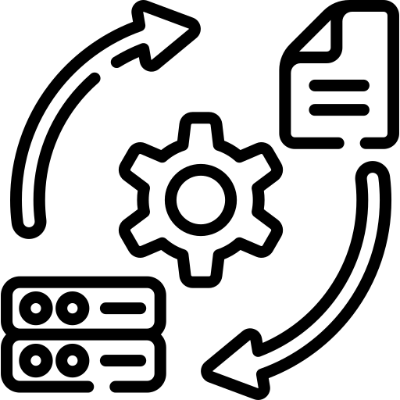















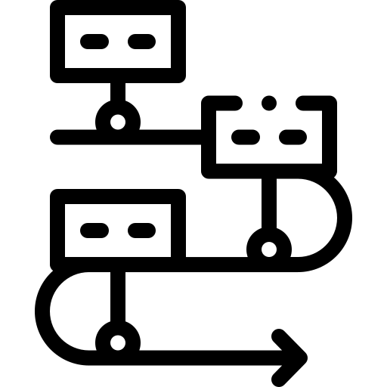
We employed an analytics-based approach to solve the problems identified in the supply chain
Raw Data
Data Cleaning
EDA
KPI Development
Shipments
Inventory
Transfers
Missing Value Treatment
Outlier Detection
Handling Inconsistent Data
Identifying Trends in Shipments & Transfers
Plotting Distributions
Summary Statistics for each dataset
Safety Stock Levels
Transfer Ratio
Customer Churn & Retention
Excess Shipment %
Analytical Modelling
Delivery Optimization
Transfer Route Optimization
Tableau
Insights & Recommendations
Python
Two Stage Stochastic Program

Slide 6
Problem Statement 1: increased intercompany transfers

Slide 7



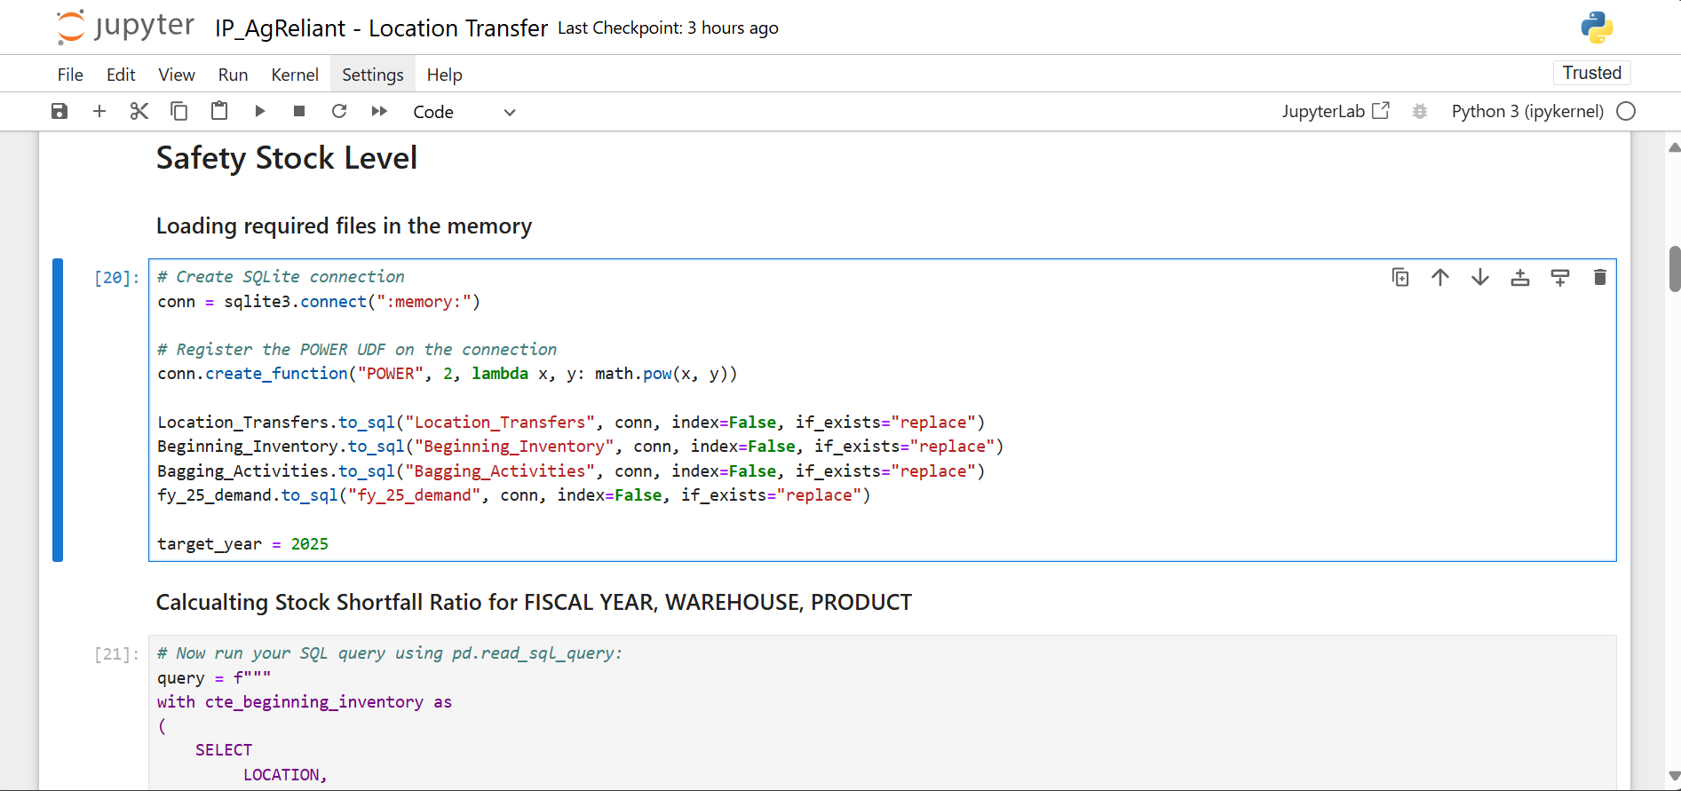
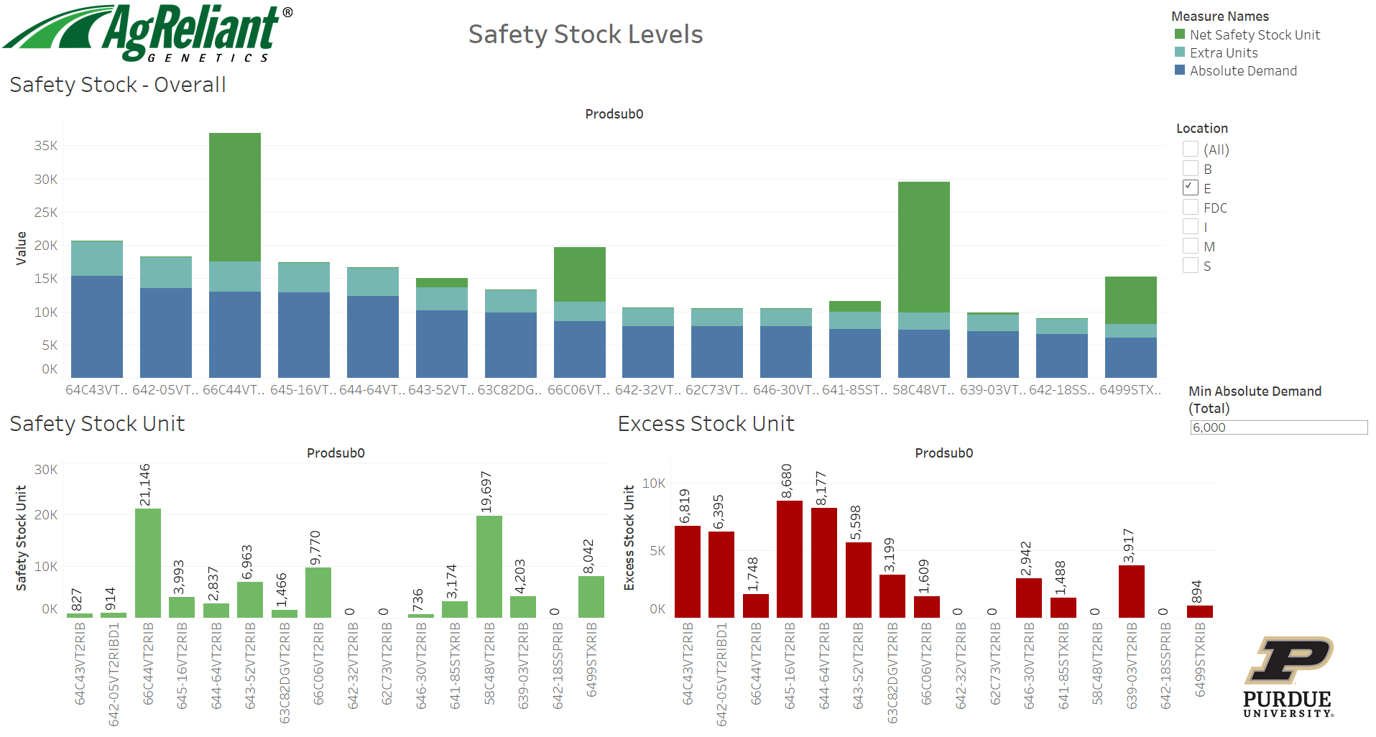
Problem Statement 1: Increased Intercompany Transfers
Business Questions
Deliverables
Implications
Tableau Dashboard that helps identify the warehouses with high intercompany transfers and determine the Safety Stock Level for the Warehouse by Product.
Improved Truck utilization -
Aligning demand and planning results to effective capacity utilization for fulfilling shipments.
Reduced Excess Shipments -
Streamlined inventory allocation decreases fragmented shipments, ensuring smoother operations and lower disruption for customers.
Which warehouses require operational interventions due to high reliance on received transfers for fulfilling shipments?
Does the timing of intercompany transfers indicate misalignment between demand forecasting and inventory planning?
How can we assign optimal buffer stock across warehouses to minimize excess inventory and reduce intercompany transfers?

Slide 8
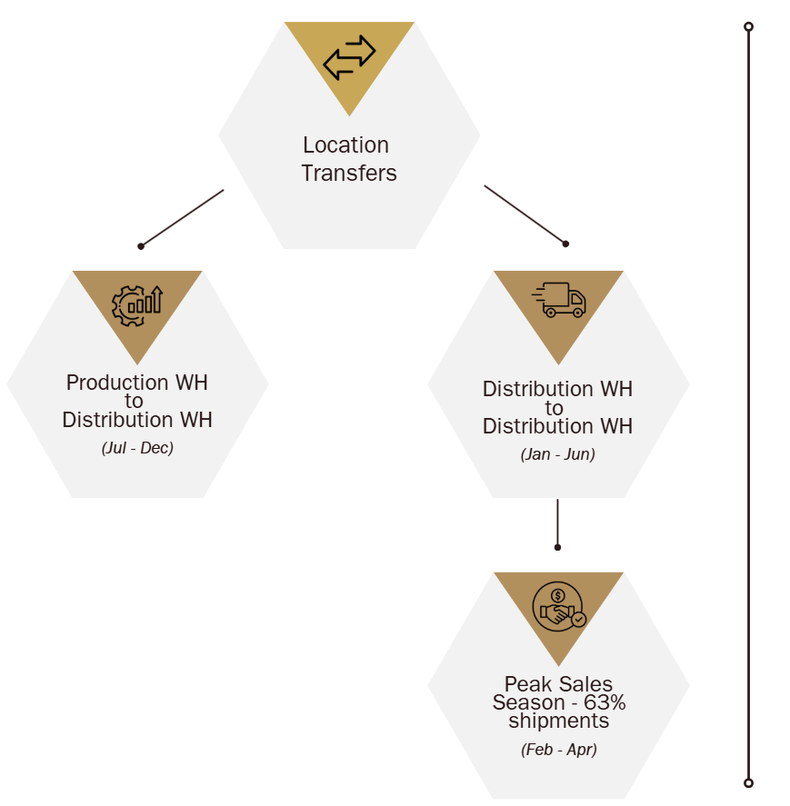
Analysis - Definition & Assumption
Base Inventory : Inventory Level before start of the sale season
Stock Shortfall Ratio = Ratio of Transfers with respect to base inventory
Stock shortfall ratio is either be stable or will follow a trend (if no intervention) over years
For FY 2025, We can assume Base Inventory = Forecasted Demand * 1.35, where 0.35 is additional planning by AgReliant for uncertainty
Shortfall Ratio has been capped at 90th Percentile to avoid unrealistic estimation of safety units

Slide 9

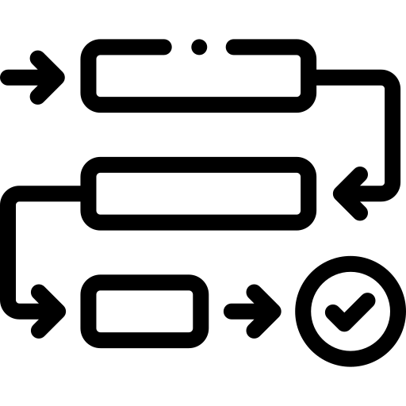




Analysis - Methodology
Inventory Level at the start of sale season = Beginning Inventory + Bagging + Transfer (IN) outside sales season - Transfers (Out) outside sales season
Stock Shortfall Ratio = Transfer (IN) during sales season / Inventory Level at the start of sale season
Excess Stock Ratio = Transfer (OUT) / Inventory Level at the start of sale season
Formulation
Exponential Weighted Moving Average (EWMA) for extrapolation of Stock Shortfall Ratio.
🏗 Base inventory for FY 25 = Forecasted Demand × 1.35
Method – EWMA
Estimate stock shortfall ratio for FY 25
Predict intercompany transfers and optimize inventory
Outcomes & Insights

Slide 10
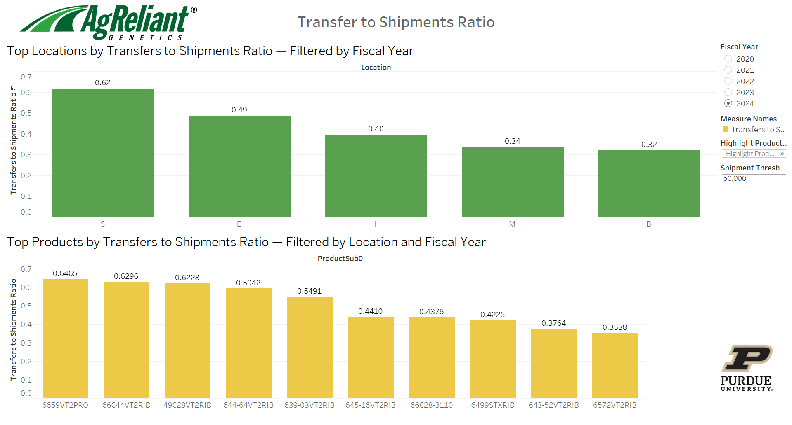
Deliverable – Dashboard 1

Slide 11
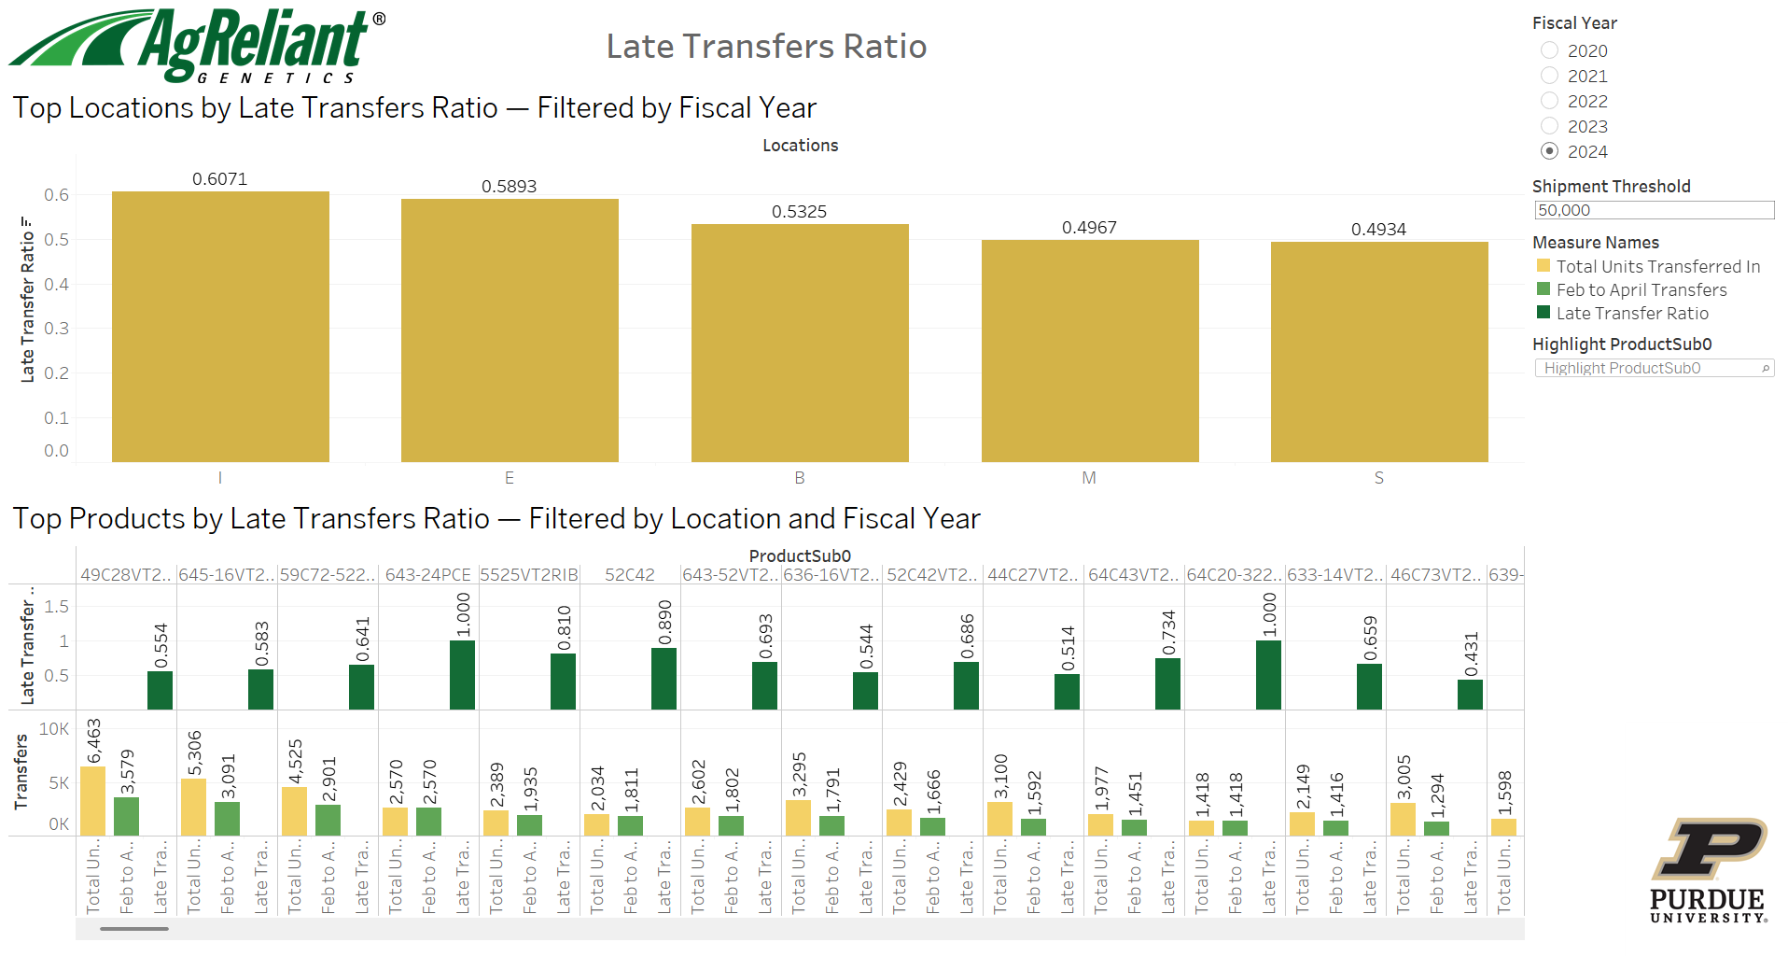
Deliverable – Dashboard 2

Slide 12
Deliverable – Dashboard 3

Slide 13

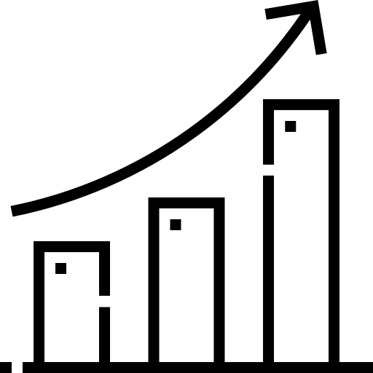

Impact Generation/Key Takeaways from Analysis
Engagement Impact
Revenue Impact
Market Impact
In 2024, appox 60% of shipments were highly dependent on Intercompany transfers for order fulfilment.
Intercompany transfers has been a major driver of logistic costs at Warehouse S in FY 2024
In Location S and E, 70% and 87% transfers were done in peak sale seasons, indicating a bigger issue in late transfers.
Warehouse | Total Trips Saved | Trip Saved Top 5 Products | Percentage
B | 68 | 3 | 4%
E | 138 | 15 | 11%
FDC | 59 | 53 | 90%
I | 65 | 15 | 23%
M | 60 | 27 | 45%
S | 376 | 191 | 51%
Total | 766 | 304 | 40%

Slide 14
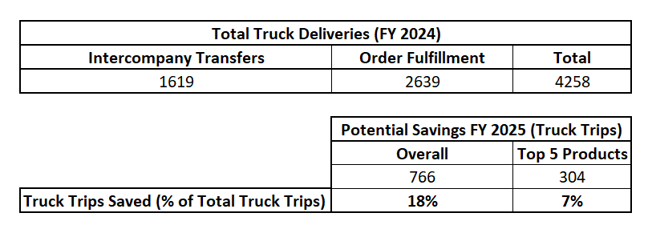
Quick check on Intercompany Transfers Saved

Slide 15
Problem Statement 2: excessive shipments

Slide 16
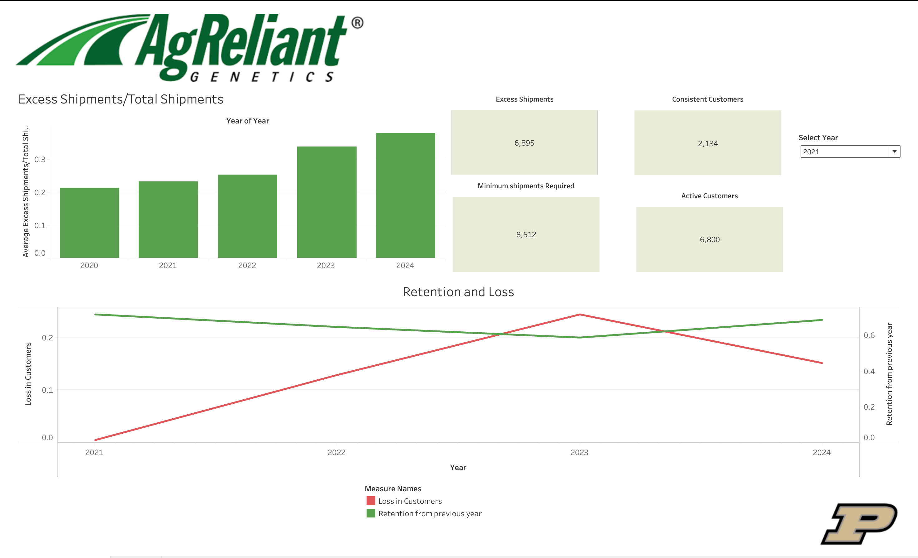
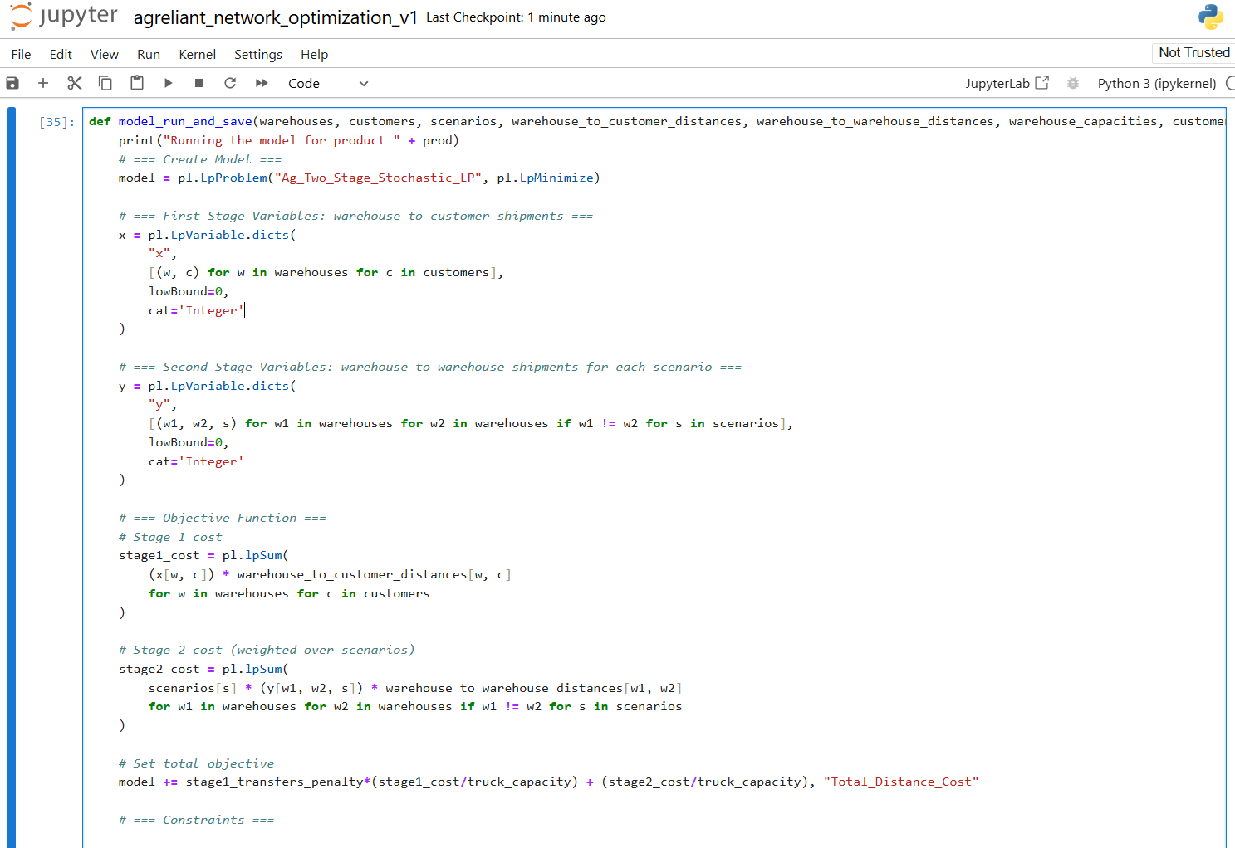
Problem Statement 2: Excessive Shipments
Business Questions
Deliverables
Implications
What is the existing approach for identifying and measuring excess shipments?
To what extent do excess shipments contribute to customer churn?
What strategies can effectively consolidate shipments for customers ordering small quantities?
Are customer purchasing behaviors consistent regardless of receiving excess shipments?
Tableau Dashboard that helps identify the customers with excess shipments and determine their activity over the years.
Excess Shipment %
Customer Churn Rate
Customer Retention Rate
Decreased Costs -
Less shipments lead to lower cost due to transportation
Efficient use of company resources
Customer Satisfaction -
Farmers receive all orders at once which makes it efficient for the farmer
This leads to AgReliant being perceived as “efficient” thereby increasing likelihood of repeat business
Notes:
“Here, we present the core business questions, deliverables, and implications of tackling excessive shipments. On the left, we see questions around identifying and quantifying excess shipments, as well as consolidating or optimizing order patterns. In the middle, we outline our key deliverables—a Tableau dashboard to pinpoint the customers most impacted, plus insights on shipment counts and retention rates. On the right, we discuss implications: reduced costs from fewer unnecessary shipments, improved service from consolidating deliveries, and higher customer satisfaction through better alignment of orders to actual needs.”

Slide 17



Approach to Identifying and Mitigating Excess Shipments
Defining Excess Shipments
Identifying Customers Affected by Excess Shipments
Studying Customer behavior
Creating KPIs

Slide 18
We created a “funnel” to narrow down the customer universe to the cohorts that were receiving multiple shipments in 2024
Of 3.7K customers, ~89% received multiple shipments even though they had not ordered more than a truck’s capacity (675 units) worth of seeds
All Customers
3.7 K
This number represents all customers found in the shipments data
Timely Customers
3.6 K
Out of all customers, these are the ones who have placed an order outside of April 15th and July 1st
Customers with multiple shipments
3.3 K
Of all timely customers, these are the one who have
received more than 1 shipment
Cohorts of Interest
549
2.7 K
Cohort 1
Customers who ordered more than 675 units of product and got more than the minimum number of shipments required
Cohort 2
Customers who ordered less than or equal to 675 units of product
Notes:
How We identified excess shipments and studied it

Slide 19
Distribution of Excess Shipments for Drop-off Customers (2022 -> 2023)
In 2022, there were ~5.8k active customers which dropped to ~4.3k in 2023. For these Customers we wanted to look at a distribution based on excess shipments

Slide 20
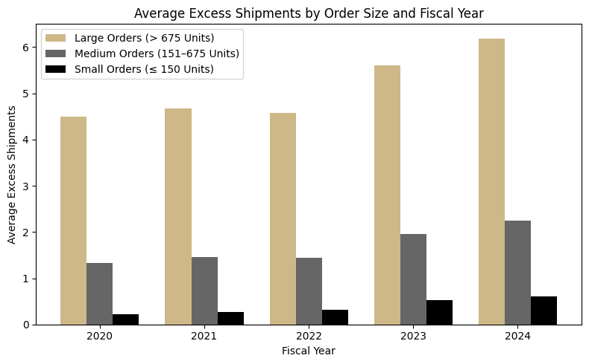
We observed larger orders had the most excess shipments, but medium orders also contributed a lot
Notes:
Analysis
Overall Excess Shipments Trend
From 2020 to 2024, average excess shipments have increased across most order sizes.
Large Orders (> 675 Units) show the highest jump, moving from an average of 4.49 excess shipments in 2020 to 6.19 in 2024.
Large Orders (> 675 Units)
Highest Average Excess Shipments: Ranging from ~4.5 to over 6.0, indicating significant consolidation opportunities.
Growing Inefficiency Over Time: The upward trend suggests existing processes may be failing to adapt to higher volumes.
Medium Orders (151–675 Units)
Moderate Excess: Average excess shipments climb from about 1.3 to 2.2 over the same period.
Substantial Customer Base: A large share of customers falls into this bracket, so even a moderate excess can translate into high total costs.
Small Orders (≤ 150 Units)
Lowest Excess: Ranging from 0.2 to 0.6 on average.
Minimal Inefficiency: This segment appears relatively optimized, though there is still room for minor improvements.
Customer Counts
Large Orders: Fewer customers overall but much higher excess shipments per customer.
Medium & Small Orders: Larger customer counts, but lower average excess shipments—though medium orders’ total excess can be significant due to the volume of customers.

Slide 21





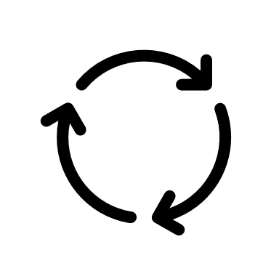

Key Metrics: Minimizing Excess and Maximizing Retention
Excess/Total
Measures the impact of excess shipments against all shipments.
Excess Shipments
Excess Shipments delivered considering demand
Consistent Customers
Tracks ‘loyal’ customers to see who are consistent
Minimum Shipments Required
Optimum number of shipments required based on demand
Retention Rate
Customers retained from previous fiscal years
Customer Loss
Loss in absolute customer counts by fiscal year

Slide 22
Dashboard

Slide 23
Key Takeaways from Analysis
Churn/Retention Impact
Order Size Analysis
Consolidation Strategy
Average excess shipments increased from 1.02 (FY2021) to 1.96 (FY2024)
Retention rate dropped from 99.23% to 85.49% over the same period
Implication: A strong correlation exists—higher excess shipments likely drive customer churn
Large Orders: Average excess shipments increased from 4.49 (2020) to 6.19 (2024)
Medium Orders: Average excess shipments increased from 1.33 (2020) to 2.24 (2024)
Implication: The significant increases in medium and large orders highlight these segments as the primary drivers of excess shipments
Optimized Inventory Coordination & Fulfilment Consolidation
Enhanced Demand Forecasting & Dynamic Order Batching
Customer Incentives & Revised Shipping Policies

Slide 24
Problem Statement 3: Delivery network optimization

Slide 25
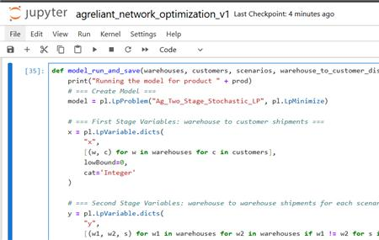
Problem Statement 3: Delivery Network Optimization
Business Questions
Deliverables
Implications
How do we reduce the overall distance travelled to deliver product to customers?
Is there a way to minimize intercompany transfers while planning for warehouse stocking?
Would removing the customer-to-warehouse mapping enhance our overall delivery efficiency?
A self serve python notebook would help the analytics team answer the business questions by using a linear programming network optimization approach
Increased Efficiency -
The network optimization approach will help improve the mapping of customers to warehouses, thereby reducing the need for intercompany transfers
Reduced Costs –
Using the model to aide planning for different customer demand scenarios will help reduce the distance travelled to fulfill orders for customers

Slide 26




Our solution is a two-stage linear programming model to minimize the distance travelled to fulfill customer demand
Model Description
2-Stage Stochastic Linear Programming with Recourse
Model Preparation
Setting up Constraints, variables and scenarios
Distance between warehouses/customers
Production Supply
Suggestion 1
Demand Scenario 1
Warehouse Capacity
Intercompany Transfers
Initial Solution
Demand Scenario 2
Customer Demand
Perfect Information
Suggestion 2
Network Optimization Model
Stage 1
Warehouse to Customer Demand
Demand Scenario 3
Suggestion 2
Stage 2 Intercompany Transfers
Minimized Distance Covered

Slide 27

Through more efficient warehouse to customer mapping, we can reduce intercompany transfers
Model Results
Approximately 16.5% of customers in FY’2024 could have been served more efficiently if tagged to more warehouses than the one they were mapped with.
Found an optimal solution for warehouse to customer mapping that reduced the requirement for intercompany transfers of 54% products
Business Benefits
Delivery Network Optimization
Reduced Intercompany Transfers
Improved Delivery Efficiency
Leveraging the network optimization model detailed in the slide above will help improve customer – warehouse mapping
Improved and dynamic mapping will allow for better planning and reduce the need for intercompany transfers
Combining network optimization results with Intercompany and Excessive shipments analyses will help improve delivery efficiency
Higher Customer Satisfaction and Retention

Slide 28




Our project delivers impact on multiple fronts as listed below
The Impact of Excessive Shipments
Identified that excessive shipments and customer growth are negatively correlated
through dashboard visualization
Identified a “Safety Stock Buffer” for Inventory Planning Stocking Top 5 products in each warehouse based on safety levels could reduce ~ 304 truck trips in FY 25, which can then be reallocated for fulfilling customer orders
Improved Warehouse to Customer Mapping
~16% of customers in FY’2024 could have been served more efficiently if tagged to more warehouses than the one they were mapped with
Reduced Intercompany Transfers
Found an optimal solution for warehouse to customer mapping that reduced the requirement for intercompany transfers of ~50% products

Slide 29

Our current deliverables also present opportunities for future enhancements
Use insights from model to improve Truck Utilization
Utilizing the existing insights from the excessive shipments analysis and the optimization model to better utilize truck capacity to reduce costs and improve customer satisfaction
04
Create a more comprehensive real-time reporting solution
Employ data engineering pipelines to connect backend data to enhanced deliverables to enable real-time reporting and optimization
03
Solve for Demand Planning and Delivery Network Optimization together
Rolling up demand forecasting and network optimization into one problem as the accuracy of the forecasts impacts the optimality of the optimization model, hence solving both together will lead to a better solution
02
Create One Integrated Stochastic Model for all Products
Modifying the definition of the stages to model transfer of products in the off-sales season (in anticipation of the demand) in the first stage, and deliveries to customers and intercompany transfers in stage 2
01

Slide 30

THANK YOU
ANY QUESTIONS?

Slide 31
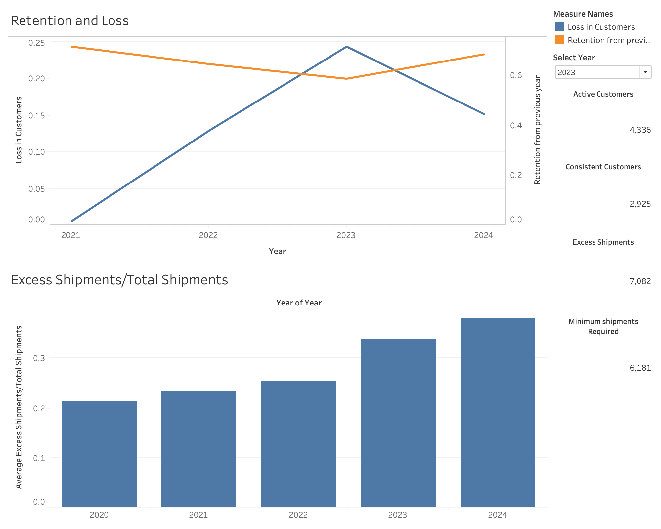
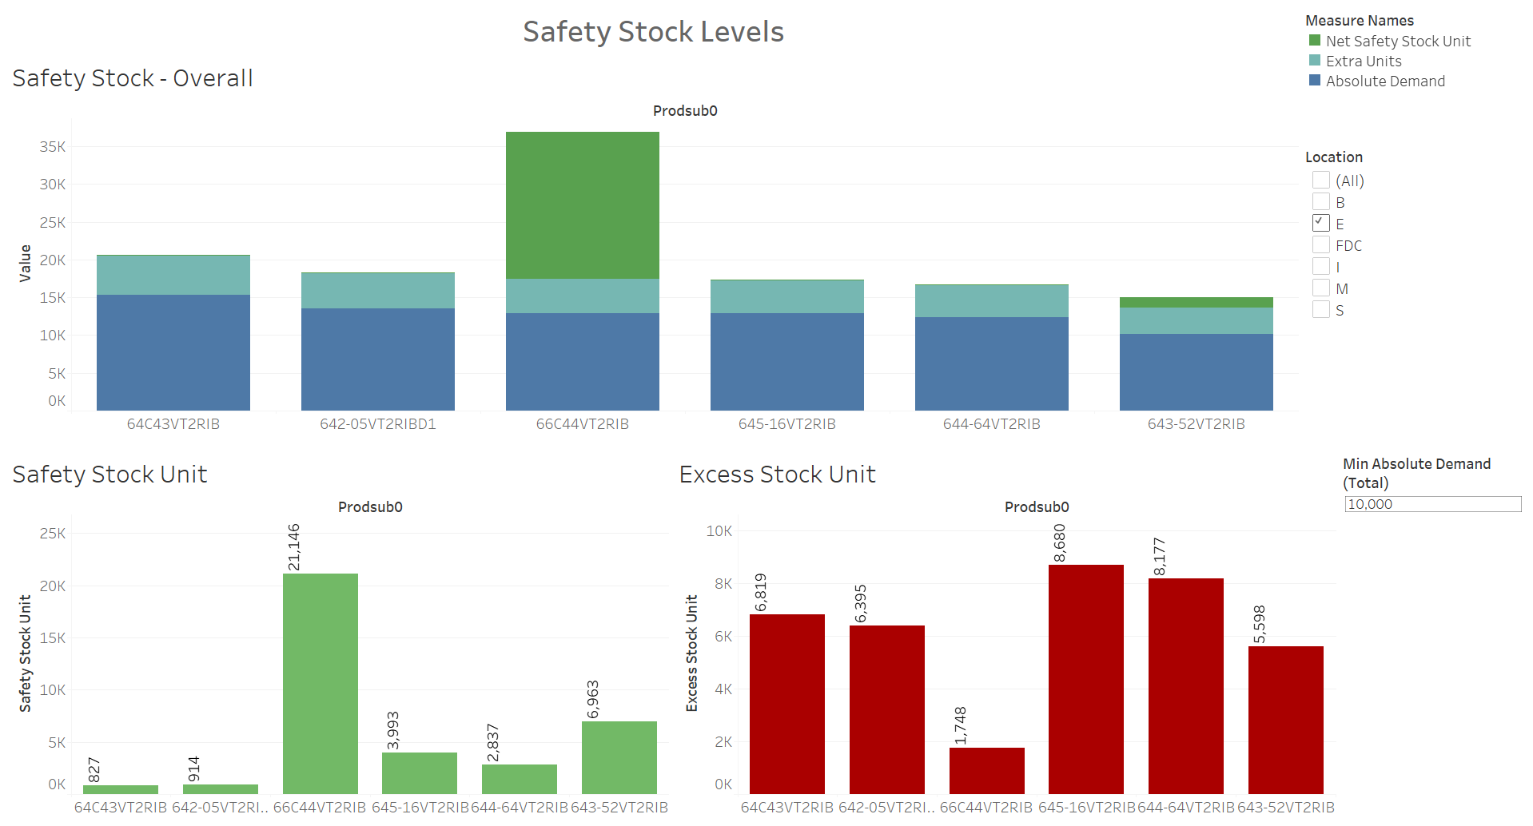
Live Demo of Deliverables
We will now walk the team through the deliverables generated for this project

Slide 32
We created a “funnel” to narrow down the customer universe to the cohorts that were receiving multiple shipments in 2024
Of 3.7K customers, ~89% received multiple shipments even though they had not ordered more than a truck’s capacity (675 units) worth of seeds
All Customers
3.7 K
This number represents all customers found in the shipments data
Timely Customers
3.6 K
Out of all customers, these are the ones who have placed an order outside of April 15th and July 1st
Customers with multiple shipments
3.3 K
Of all timely customers, these are the one who have
received more than 1 shipment
Cohorts of Interest
549
2.7 K
Cohort 1
Customers who ordered more than 675 units of product and got more than the minimum number of shipments required
Cohort 2
Customers who ordered less than or equal to 675 units of product

Slide 33
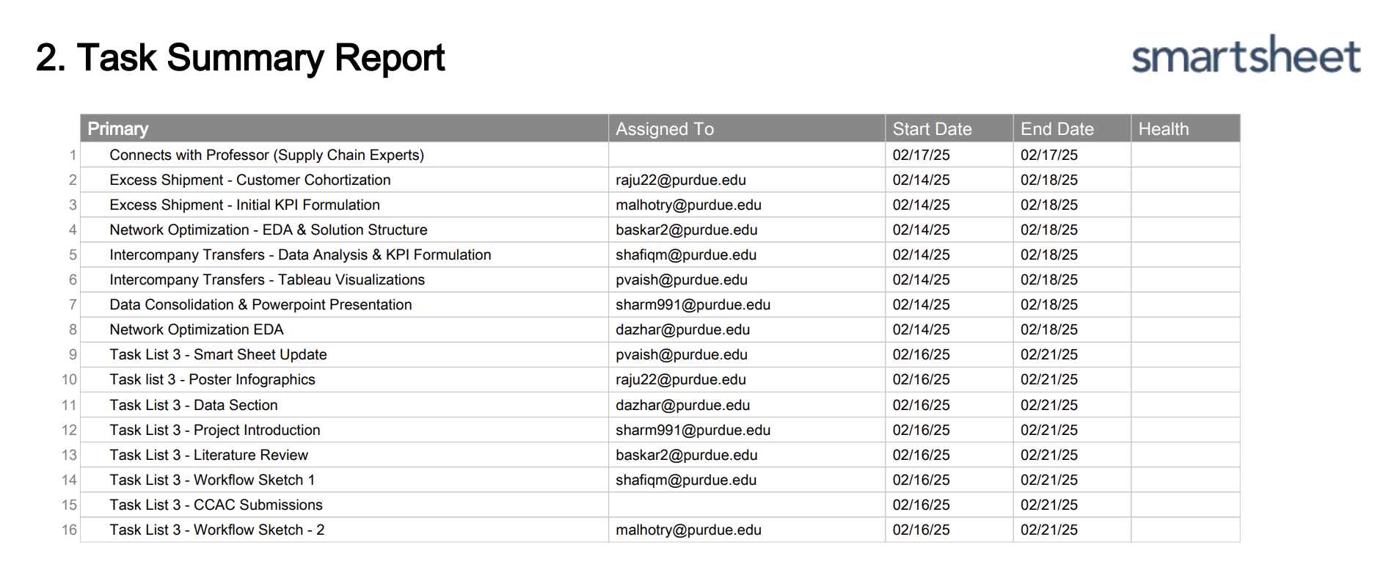
Task Tracking – Task List #3
Smartsheet Link: https://app.smartsheet.com/sheets/w6q3mJ7X5Jvp5r689rgrH837h77CCqqMGHjfV7x1?view=board

Slide 34
Appendix

Slide 35



Executive Summary
Frequent and fragmented shipments are driving up logistics costs and creating inefficiencies in our delivery process, while also negatively impacting our customers' operations
Excessive intercompany transfers between our locations are leading to logistical inefficiencies and longer lead times, ultimately affecting our ability to deliver products efficiently to customers
Inefficient mapping of warehouses to customer locations is causing delivery delays and increased transportation costs, hindering our overall supply chain effectiveness.
Business Problem
KPI Monitoring Dashboard: A Tableau dashboard tracks excess shipments and intercompany transfers to identify supply chain inefficiencies and guide operational decisions.
Data-Driven Efficiency Improvements: Insights from the dashboard inform optimization strategies, helping to reduce logistics costs through consolidation, route optimization, and demand forecasting.
Dynamic Network Optimization: A self-serve Python notebook enables scenario-based optimization of customer-to-warehouse mapping to improve delivery efficiency and reduce redundant transfers.
Solution Approach
Implementing stocking for top 5 products per warehouse based on safety level insights can save ~304 truck trips in FY’25.
~16% of FY’2024 customers could benefit from multi-warehouse mapping for improved efficiency.
Optimized warehouse-customer mapping reduced intercompany transfers for ~50% of products in FY’24.
Expected Impact

Slide 36

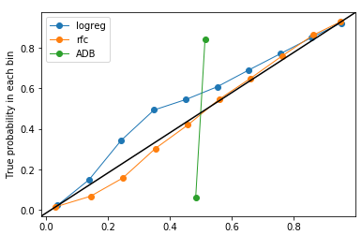
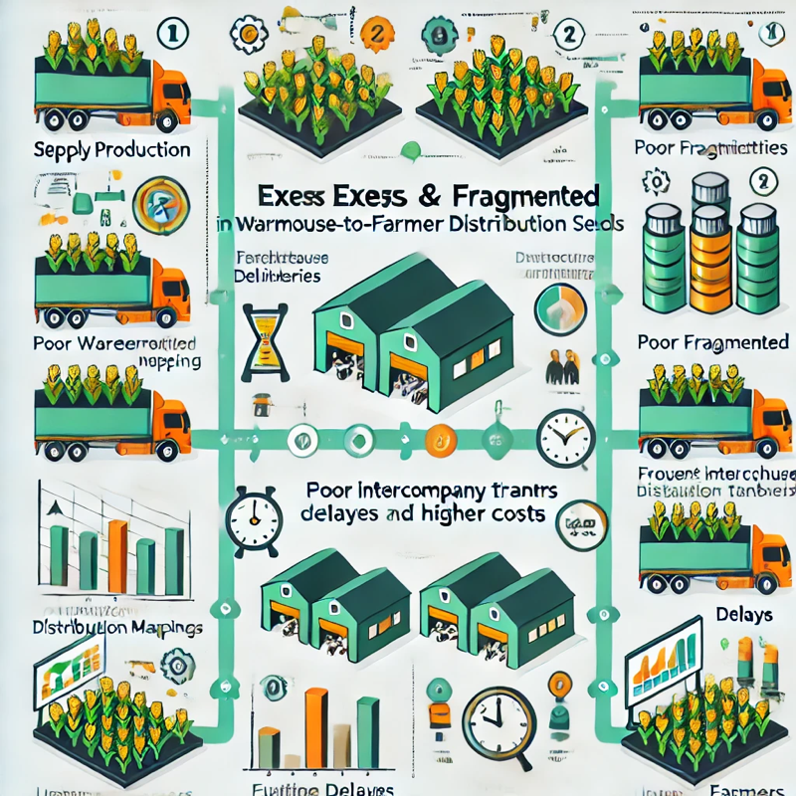
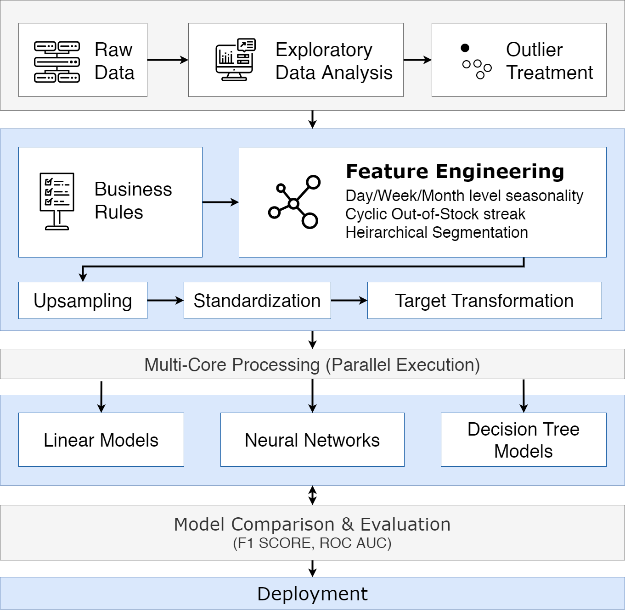
Project Poster – WIP
Using Python Libraries to Predict, Optimize, and Provide End Users Decision Confidence
Student A, Student B, Student C, Student D, Student E,
Matthew A. Lanham
Purdue University, Krannert School of Management
studentA@purdue.edu; studentB@purdue.edu; studentC@purdue.edu; studentD@purdue.edu; studentE@purdue.edu; lanhamm@purdue.edu
LITERATURE REVIEW
STATISTICAL RESULTS
EXPECTED IMPACT
Summarize what you found in the papers you read and try to make an argument that what you have done in your project has not been reported on previously.
Sometimes people will create a table in Excel that has certain aspects that the papers you read have, then show that your study compares to the previous studies….
Discuss the “expected or potential” impact the performance of your model could have. Since you did not work directly with a company, you are framing this as a potential scenario in a how a company could benefit from your insights.
Create a nice-looking plot(s) in Tableau, Excel, or R. Ideally this figure(s) would be one of a few things:
Translate your statistical results to potential business results/impact
If an interpretable model, discuss the impacts/effects on the outcome with corresponding confidence intervals
If prediction accuracy was a focus, say an 80% accuracy (from your best model) versus a 75% accuracy, how does this 5% improvement impact the business business, customer, or other stakeholder?
Discuss the performance of your models and refer to the figure. Don’t use a table, create a nice-looking plot(s) in Tableau, Excel, or R.
ABSTRACT
What are you doing? – why are you doing it? – how was it done? (in this order). This isn’t a paper. Be very concise like a robot ☺.
Study | ARIMA | ANN | RF | LMT | Ensemble
Dimitris Papakiriakopoulos, 2011
M.W.T. Gemmink, 2017
Enzo Morosini Frazzon, 2019
Bart L MacCarthy, 2019 | Used a generalized store wave picking model
Our Study, 2020
INTRODUCTION
Motivate why the problem is important …
Maybe add in a pretty illustration of what you’re talk about…Remember a poster is NOT a paper, but a high-level overview of you what you investigated. You are sort of using your poster like a PowerPoint deck and thus will want more BEAUTIFUL figures and CONCISE language.
50.6 M
METHODOLOGY
Fig 3. Model Results
Fig 4. Probability Calibration Plot
11.5 M
2.1 M
2.3 M
5.9 M
21 M
50.6
Discuss the performance of your models and refer to the figure. Don’t use a table, create a nice-looking plot(s) in Tableau, Excel, or R.
7.9 M
Produce
Deli
Meat
Grocery
Seafood
Others
Total
Fig 5. Total Net Savings ($) based on predicted OOS instances
CONCLUSIONS
Additional filler… Remember to use high quality figures people can read
XXXXXXXXXXXXXXXXXXXXXXXXXXXXXXXXXXXXXXXXXXXXXXXXXXXXXXXXXXXXXXXXXXXXXXXXXXXXXXXXXXXXXXXXXXXXXXXXXXXXXXXXXXXXXXXXXXXXX
Provide answers to your research questions here, possibly using bullet points to be clear to your reader.
Anything else you feel is an important take-away that led to your result (e.g. how you created features, the models or software you used, etc.). If nothing important comes to mind, how do you think your project and insights could be improved based on your studies limitations (e.g. available data, domain knowledge, technology barriers, etc.)
Fig 3. Model Results
Fig 4. Probability Calibration Plot
RESEARCH OBJECTIVES
Clearly state your research question(s) with bullets:
What are the most important drivers for identifying OOS rate at product-store level?
What is the business impact and stock availability across Business Units?
ACKNOWLEDGEMENTS
We would like to thank Professor Matthew Lanham and our industry partner for this opportunity, their guidance, and support on this project.
Fig 3. Model Results
Fig 4. Probability Calibration Plot

Slide 37
Problem Statement 3: Increased Intercompany Transfers
Implications
Business Questions
KPIs Proposed
Supply Chain Inefficiencies -
Overburdened locations managing both high shipment volumes and transfers.
Long-distance transfers causing delays and higher costs.
Customer Dissatisfaction
Transfers improve order fulfillment rates but may delay deliveries.
Excessive reliance on transfers can negatively affect customer experience.
Do you track transfer costs (e.g., transportation, handling)?
Are there seasonal trends or behaviors driving higher transfers?
What KPIs measure intercompany transfer success (e.g., delivery time, fulfillment rate)?
Is a specific seed type at a warehouse driving transfers?
Are there any current goals or limits that AgReliant has set to minimize this?
Recommend optimal inventory placement to reduce transfers.
Analyze customer demand patterns leading to transfers.
Predict future demand using historical data.
Identify seasonal patterns in transfers and shipments.
… Anything else??

Slide 38
Meeting on 18th Feb

Slide 39
AGENDA
Excessive Shipments Analysis
Potential KPI List
Network Optimization - Approach

Slide 40
We created a “funnel” to narrow down the customer universe to the cohorts that were receiving multiple shipments
Prelim
Of 8K customers that received multiple shipments, ~72% received multiple shipments even though they had not ordered more than a truck’s capacity (675 units) worth of seeds
All Customers
11.2 K
This number represents all customers found in the shipments data
Timely Customers
11 K
Out of all customers, these are the ones who have placed an order outside of April 15th and July 1st
Customers with multiple shipments
8 K
Of all timely customers, these are the one who have
received more than 1 shipment
Cohorts of Interest
2.3 K
5.6 K
Cohort 1
These are customers who ordered more than 675 units of product
Cohort 2
Customers who ordered less than or equal to 675 units of product
The team will carry out further analysis on these customers to understand geographic and time-related trends/insights

Slide 41
Methodological Framework
Analytically, we aim to follow a three-step process to get to supply chain improvements for AgReliant
EDA
KPI Creation and Evaluation
Potential Improvements
Analyze shipment and warehouse transfer data to identify patterns, redundancies, and inefficiencies.
Examine delivery frequency per customer and warehouse-to-customer mapping to detect consolidation opportunities.
Assess seasonal trends, regional differences, and cost variations in logistics.
Develop a dashboard showcasing excess shipments and their impact on customer retention and losses.
Implement a network optimization model to help improve efficiency of deliveries to customers.
Design a dashboard for intercompany transfers to reduce transfers during peak seasons and calculate safety stocks in inventory.
Reduce redundant deliveries and intercompany transfers by optimizing shipment consolidation strategies to minimize logistics costs.
Implement dynamic customer-to-warehouse mapping to distribute supply more efficiently.
Identify opportunities for route optimization, warehouse repositioning, or demand forecasting to enhance efficiency.

Slide 42
Developing KPIs to Optimize Transfers & Minimize Excess Shipments
KPI | Brief Description | Rationale for Usage
Safety Stock Level | Measures extra “buffer” units stocked beyond forecasted demand. Calculated as the moving average of units transferred between warehouses. | Helps assign optimal buffer stock to minimize excessive transfers. Identifies warehouses with inflated forecasts, enabling reallocation of excess inventory.
Shipment-to-Received-Transfers Ratio | Formula: (# of Shipments in an FY) / (# of Transfers Received) | Helps prioritize warehouse actions based on transfer dependency. Identifies warehouses needing intervention or optimization.
Late Transfer Ratio | Formula: (# of Transfer in March & April) / (Total Intercompany Transfers) | Indicates the share of last-minute transfers close to peak delivery periods. Helps assess if inventory planning aligns with demand forecasts.
Optimal Transfer Warehouse | Identifies the nearest warehouse capable of fulfilling a transfer. | Derived from network optimization analysis. Ensures efficient stock reallocation by matching supply with demand.

Slide 43
Meeting on 7th Feb

Slide 44
We identified a total of 6 business problems, 3 of which we plan to address within this project
These problems are within project scope
Delivery Inefficiency: Excess Shipments - Frequent, fragmented shipments increase costs and disrupt customer operations.
Warehouse Mapping to Customer - Inefficient mapping of warehouses to customers leads to delays and higher transportation costs.
Intercompany Transfers - Excessive transfers between company locations result in logistical inefficiencies and increased lead times.
Overlap of Supply Planning Cycle with Sale Seasons - Misaligned supply planning with peak sales seasons causes stockouts or overstocking.
Reliance on Contractors for Seed Production - Overdependence on contractors introduces variability in quality and supply timelines.
Falling Customer Retention - Declining customer loyalty due to perceived inefficiencies and dissatisfaction with delivery and service.

Slide 45
Problem Statement 1: Delivery Inefficiency
The Hidden Costs and Impacts of Excess Shipments: Financial Strain, Farmer Discontent, and Brand Perception Risks
Implications
Questions
Initial KPI List
Increased Costs -
More shipments mean more cost due to transportation
Inefficient use of company resources to account for more shipments
Customer Dissatisfaction
Farmers receive orders in a fragmented manner which causes dissatisfaction
This leads to AgReliant being perceived as “inefficient” thereby reducing likelihood of repeat business
How many shipments to a customer are considered as 'excess shipments’?
When are 'excess shipments' acceptable?
How do we map a shipment to an order?
What is the current methodology used to identify excess shipments?
What is the timeline for when a customer orders and a shipment is delivered?
How are shipments prioritized apart from the cadence in which orders are placed?
How are orders processed into shipments?
Perfect order: % of orders that delivered in full and on time with lowest possible shipments
Avg number of shipments per order
Truck capacity utilization rate
Avg time from order placement to delivery
# of shipments requiring intercompany transfers
# Returns due to incorrect shipments
… Anything else??
Additional Data Required: Order Data, Fulfillment, Truck Utilization

Slide 46
Problem Statement 2: Customer to Warehouse Mapping
Would adding another warehouse to our network improve efficiency and reduce costs in the long term?
Implications
Questions
Initial KPI List
Increased Efficiency -
A new warehouse can serve more demand in the area, reducing the load on the existing warehouses
It can serve more demand, hence increasing revenue
Reduced Costs -
A warehouse that is closer to a group of customers can lead to reduced transportation cost
This reduced cost and increase in revenue in the long term should offset the cost of the warehouse
Is there an optimal number of customers a warehouse should serve?
What other metrics would you recommend that we calculate to solve this problem?
Can this be modelled as a network optimization problem?
What would be the constraints to the objective function in such a problem?
Does initial tagging of a customer to a warehouse happen based on proximity?
Ratio of Number of Customers to number of Warehouses in a state
Distance to the customer per warehouse (Average and Three Quartiles)
… Anything else??

Slide 47
Problem Statement 3: Increased Intercompany Transfers
Understanding and mitigating inefficiencies in intercompany transfers to optimize inventory flow, reduce costs, and enhance supply chain responsiveness.
Implications
Questions
Initial KPI List
Supply Chain Inefficiencies -
Overburdened locations managing both high shipment volumes and transfers.
Long-distance transfers causing delays and higher costs.
Customer Dissatisfaction
Transfers improve order fulfillment rates but may delay deliveries.
Excessive reliance on transfers can negatively affect customer experience.
Do you track transfer costs (e.g., transportation, handling)?
Are there seasonal trends or behaviors driving higher transfers?
What KPIs measure intercompany transfer success (e.g., delivery time, fulfillment rate)?
Is a specific seed type at a warehouse driving transfers?
Are there any current goals or limits that AgReliant has set to minimize this?
Recommend optimal inventory placement to reduce transfers.
Analyze customer demand patterns leading to transfers.
Predict future demand using historical data.
Identify seasonal patterns in transfers and shipments.
… Anything else??
Additional Data Required: Transportation costs

Slide 48
Questions from Exploratory Data Analysis – Part 1
Table | Questions from EDA
Beginning Inventory | What is the significance of 31st July as 'Activity date'? If the date in the table is 31st July, does it mean that is the end of that fiscal year? In the product code, what does the code mean? (80K.L , 80K.A , 80K.W , 40K.L , 40K.A ) What is package type = 'SS'?
Bagging Activity | Would it be relevant for us to understand the different codes for ACTIVITYCODE and PACKAGETYPE? <1% of net units in bagging activities is negative, is that a concern?
Disposal Activity | 5.9% of net units in the disposal activities table are positive, why would that be the case? Can we get some more clarity regarding the disposal activity types mentioned (e.g., DISPO-OPH, DISPO-OBL, DISPO-OPH-PY?)
Returns | Are orders returned to the same warehouse from where they were shipped? In case it can be returned to the other warehouse then what does the location field mean? Why do we have a mix of negative and positive values in the net unit field? How can we map returns to orders and shipment? Is there a scope of partial returns, if yes, how do we identify them?

Slide 49
Questions from Exploratory Data Analysis – Part 2
Table | Questions from EDA
Location Transfer | What does it mean when the to and from locations are the same? Why do we have a mix of negative and positive values in the net unit field? What does the SS category mean in PACKAGETYPE columns? What does the last part in PRODUCTCODE mean i.e., 40K.L, 80K.A etc.?
Shipments | There is a location C in the shipment table that does not have a corresponding entry in location table, this location had only returns from 2020-2022, some sales in 2023 and returns again in 2024 There are 60 FY-Location combinations in the Shipment table where the Location in Shipment does not have a corresponding location in the Location Transfers table <1% of net units in the shipment table contain positive values There are ~5K customers who have received shipments from more than one location – considering the current mapping of customers to one warehouse, why is this happening?

Slide 50
When trying to tally netunits across tables, we ran into some confusion
a
b
c
d
e
f
g
h
2023 Beginning Inventory
Bagging
Units sent to other location
Units received from other location
Units Shipped to customers
Units returned from customers
Units disposed at end of year
2024 Beginning inventory
Ideal Case:
a + b – c + d – e + f – g = h
Observation: The above equation doesn’t seem to be satisfied based on the “Net Units” present in the data

Slide 51
Business problem slides

Slide 52
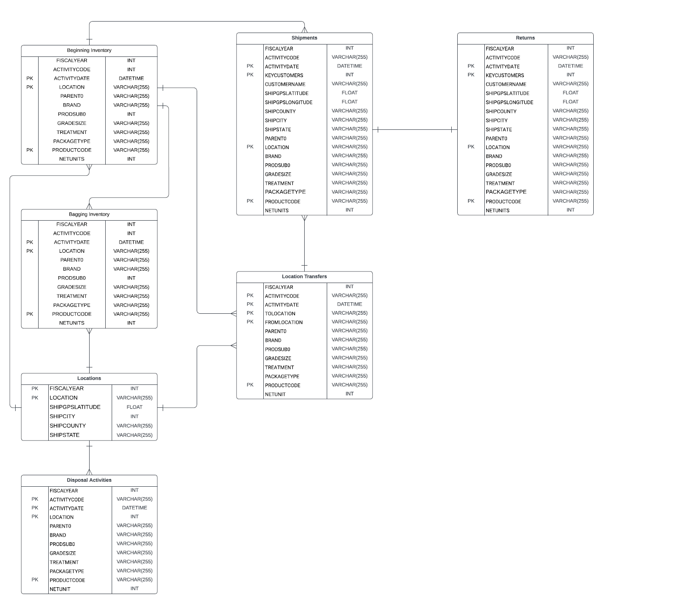
As part of initial Exploratory Data Analysis, the team created an Entity Relationship Diagram for the tables shared with us
Lucid Chart: https://lucid.app/lucidchart/4a491fc6-a5fa-44f6-bdc0-736279ea1208/edit?viewport_loc=-587%2C357%2C4026%2C2319%2C0_0&invitationId=inv_a1bc24cc-7107-4092-8199-2b5274617c5a

Slide 53
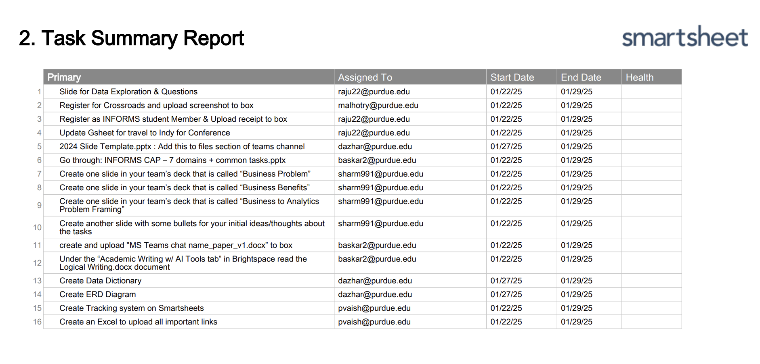
Task Tracking – Week 1
Smartsheet Link: https://app.smartsheet.com/sheets/w6q3mJ7X5Jvp5r689rgrH837h77CCqqMGHjfV7x1?view=board

Slide 54
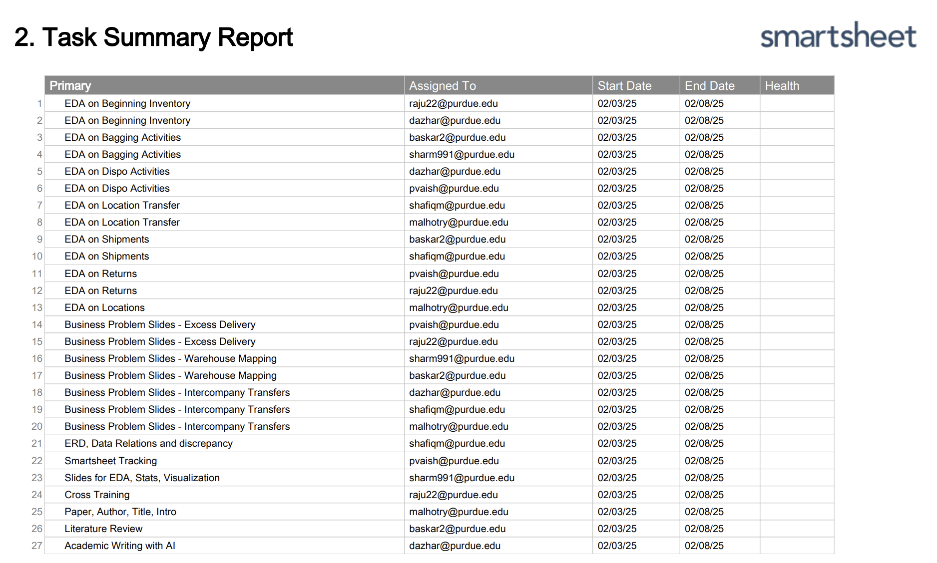
Task Tracking – Week 2
Smartsheet Link: https://app.smartsheet.com/sheets/w6q3mJ7X5Jvp5r689rgrH837h77CCqqMGHjfV7x1?view=board

Slide 55
Business Problem
Evaluate AgReliant’s supply chain and suggest improvements
The project team is to first provide an evaluation of AgReliant’s current supply chain using common KPIs.
The team will then provide recommendations for improvements in the supply chain.
The recommendations should indicate expected cost savings or measures of increased efficiency.

Slide 56
Business Benefits
Improvements in AgReliant’s Supply Chain could drive $XX in saved costs
A detailed evaluation of AgReliant’s supply chain would help develop Key Performance Indicators that would measure the efficiency of the shipping and intercompany location transfers
Using these metrics, the project team will propose improvements that would lead to potential cost savings of $XX*
Additionally, through their improved supply chain, AgReliant would have faster and more efficient order fulfillment which would lead to increased customer satisfaction
* The actual dollar amount will be updated at a later stage in the project

Slide 57
Business to Analytics Problem Framing
Analytically, we aim to follow a three-step process to get to supply chain improvements for AgReliant
EDA
KPI Creation and Evaluation
Potential Improvements
Analyze shipment and warehouse transfer data to identify patterns, redundancies, and inefficiencies.
Examine delivery frequency per customer and warehouse-to-customer mapping to detect consolidation opportunities.
Assess seasonal trends, regional differences, and cost variations in logistics.
Measure delivery frequency per customer and evaluate the impact of multiple shipments on logistics costs.
Assess warehouse utilization, delivery distances, and cost per shipment to quantify supply chain efficiency.
Visualize current customer-to-warehouse mapping and explore alternative configurations for optimization
Reduce redundant deliveries by optimizing shipment consolidation strategies to minimize logistics costs.
Implement dynamic customer-to-warehouse mapping to distribute supply more efficiently.
Identify opportunities for route optimization, warehouse repositioning, or demand forecasting to enhance efficiency.

Slide 58
Business to Analytics Problem Framing
The prioritization of tasks for our analytical process would look as below:
Analyze shipment data to identify customers receiving multiple deliveries and quantify cost inefficiencies.
Analyze seasonal trends to determine demand fluctuations and identify areas for better inventory planning.
Measure KPIs such as delivery frequency, cost per shipment, and warehouse utilization to establish a baseline.
Assess customer-to-warehouse mapping and identify potential inefficiencies in the one-to-one mapping strategy.
Explore customer-to-warehouse reallocation by simulating one-to-many mappings and measuring expected efficiency gains.
Develop shipment consolidation strategies to reduce redundant deliveries while maintaining service levels.
Explore establishing new warehouses/fulfillment centers in new locations in the AgReliant network to improve delivery efficiency

Slide 59
Data Learnings
Below are the learnings from the dataset so far:
Beginning Inventory table contains the carry forward inventory from the previous FY
Bagging Activities table contains the seed production data for that FY
Dispo Activities table contains data about quantities disposed due to QA failure or because they’re orphan units
Location Transfer table contains data about transfers between warehouses, with the activity code indicating the type of inventory activity (SAIL refers to a shipment made to a customer, BegBal is the beginning balance of the warehouse)
Shipments table contains data regarding orders made to customers, and the Returns table contains data regarding customer returns

Slide 60
Data Learnings
Below are the specific caveats/features of the columns:
Parent0 – an ID column that identifies the corn hybrid, it is a 10 digit code. If it ends with ‘R’ as the 11th digit, then the hybrid is used for Refuge in Bag (95-5 GMO to Non GMO corn mix to help with pest resistance to the GMO activity)
Net units – The flow is always calculated relative to the warehouse, hence returns are positive and sales are negative. The unit conversion is already done in the data (we don’t need to multiply by 50 if the unit is boxes)
Distance between the warehouses, and from the warehouse to the customer to be used as a proxy of cost (this is the main cost, storage costs or inventory turns are out of scope at the moment)

Slide 61
Problem Statement 1: Delivery Inefficiency
Increased Costs: Extra shipping leads to higher transportation, warehousing, and handling costs.
Higher Transportation Costs: More shipments mean additional fuel, labor, and vehicle wear-and-tear expenses
Logistical Inefficiencies: Increased use of resources like packing materials, warehouse space, and handling time.
Customer Dissatisfaction: Receiving more than needed can confuse or frustrate customers, especially if it complicates their planting schedules.
Inconvenience to Farmers: Frequent deliveries can disrupt farm operations, requiring farmers to allocate time and resources for multiple shipments.
Perceived Lack of Efficiency: Farmers may perceive AgReliant as disorganized or unreliable, which could erode trust.
Potential for Errors: More shipments increase the chances of errors like missed items, damaged goods, or delivery to the wrong address.
Farmers may associate frequent shipments with poor planning and service inefficiencies, tarnishing AgReliant's reputation as a trusted partner

Slide 62
How to improve delivery efficiency to customers?
Initial Questions
How many shipments are considered as 'excess shipments'?
When are 'excess shipments' acceptable? Examples:
# Ordered units exceeds truck capacity
Different seeds are ordered from different locations
How do we map a shipment to an order?
How to identify whether a shipment is for a single order or if it is for multiple orders?
Is there an Orders table?
What is the current methodology used to identify excess shipments?
Is there a buffer time considered while separating the orders and recording the shipments to classify them as 'excess shipments'?
What is the timeline for when a customer orders and a shipment is delivered?
How are shipments prioritized apart from the cadence in which orders are placed?
How are orders processed into shipments?

Slide 63
What can we track or evaluate?
Perfect order: % of orders that delivered in full and on time with lowest possible shipments
Avg number of shipments per order
Truck capacity utilization rate
Avg time from order placement to delivery
# of shipments requiring intercompany transfers
# Returns due to incorrect shipments
Any other bottlenecks that we can investigate?

Slide 64
Exploratory data analysis

Slide 65
EDA – Trend of Sales
Net units sold is declining year on year, and this is trend is mirrored in the top states contributing to sales
The pareto is not very strong as Group 1 (containing all states out of top 15 in terms of sales) still performs 7th best overall

Slide 66
EDA – Trend of production and disposals
Trend of production has been erratic across plants and over the years, with no clear trend. Need information from the client as to why production was entirely halted at some sites, while it has dropped at others
Trend of disposals has also been erratic, with some plants requiring a lot of disposals and showing an increasing trend over the years

Slide 67
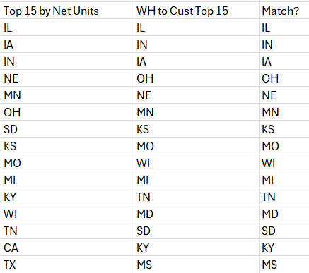
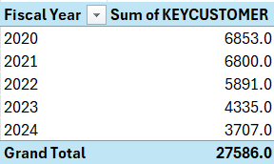
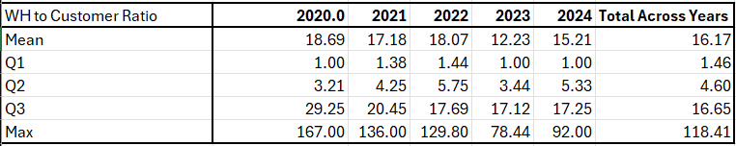
EDA – Customer to Warehouse Ratio
The trend of customers served by a warehouse is skewed right, with some states having a very high ratio and some states having a lower ratio. We can see this in the table above as the mean is significantly higher than the median
We can also see that the states with the greatest number of customers have a higher ratio, which is intuitive. What is required is to break this EDA down by location of the warehouse and location of the customer, to find out if customers in a state are being served by a warehouse in that state or in a neighboring state

Slide 68
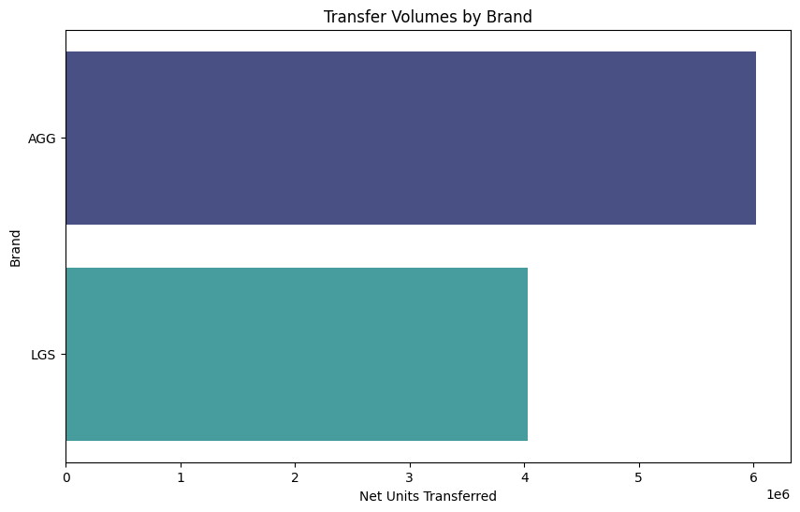
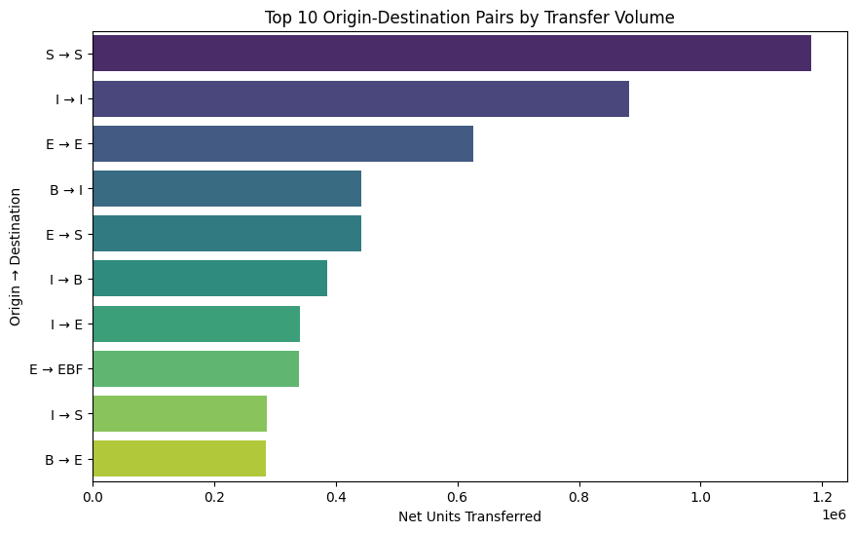
EDA – Trend of Location Transfers
The highest transfer volumes occur within the same locations (e.g., S → S and I → I), suggesting internal movements or inventory adjustments within facilities.
The brand AGG accounts for higher transfer volumes compared to LGS, suggesting potential inventory imbalances or higher demand variability for AGG products.

Slide 69
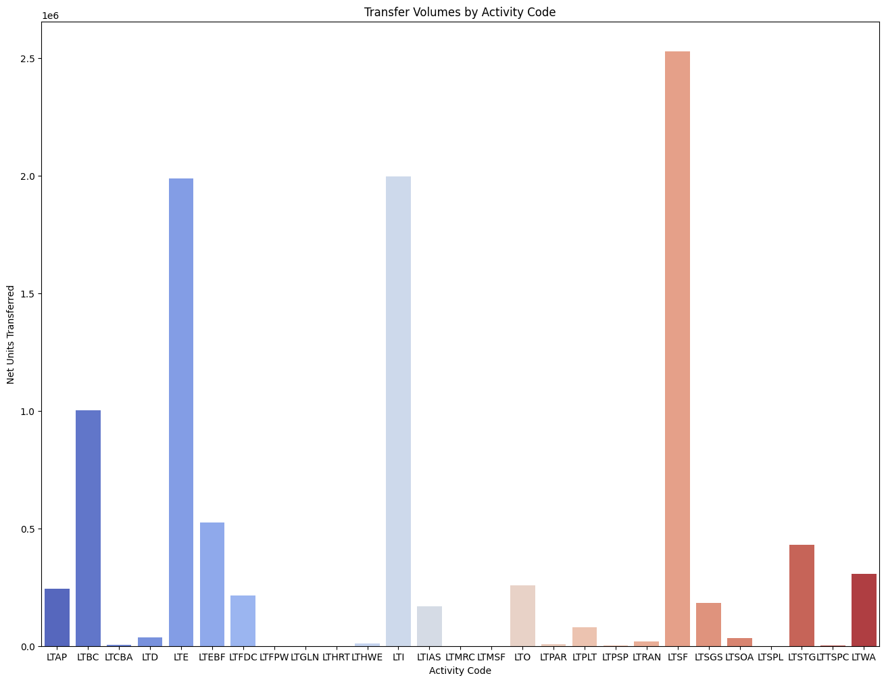
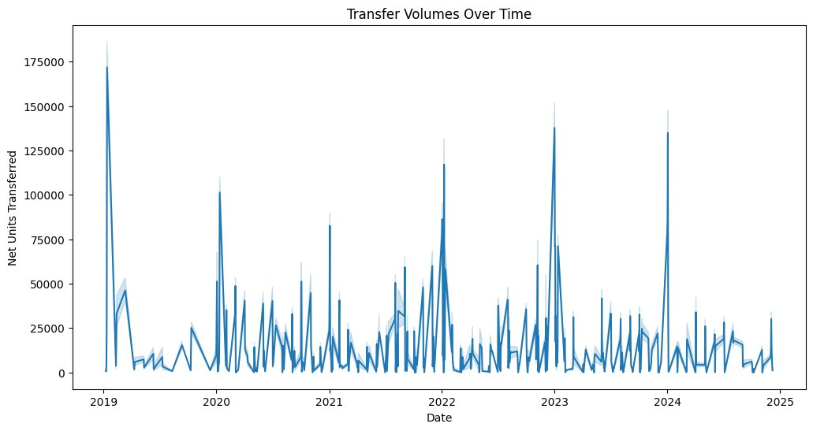
EDA – Trend of Location Transfers
Certain activity codes, such as LTSF and LTE, dominate transfer volumes, indicating specific operational processes driving the majority of transfers.
Transfer volumes show periodic spikes, indicating seasonal or operational peaks that may align with demand surges or inventory repositioning needs.

Slide 70
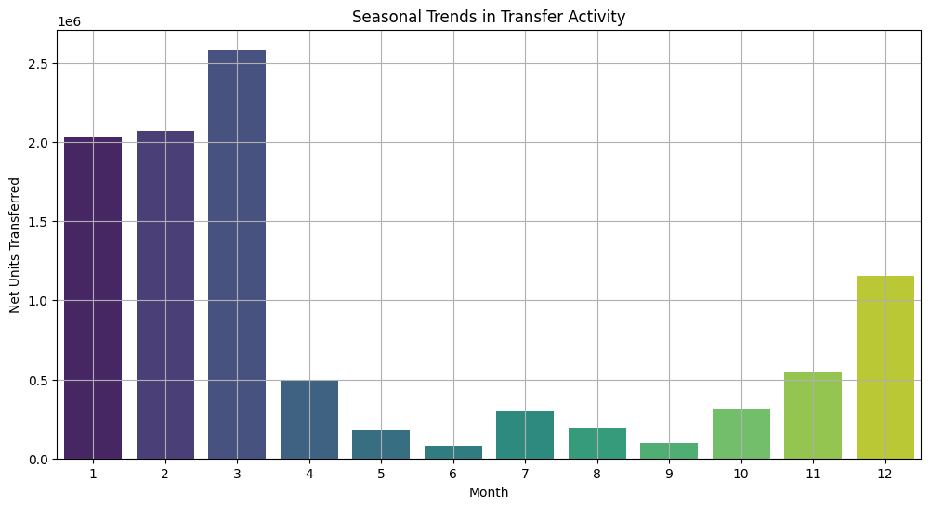
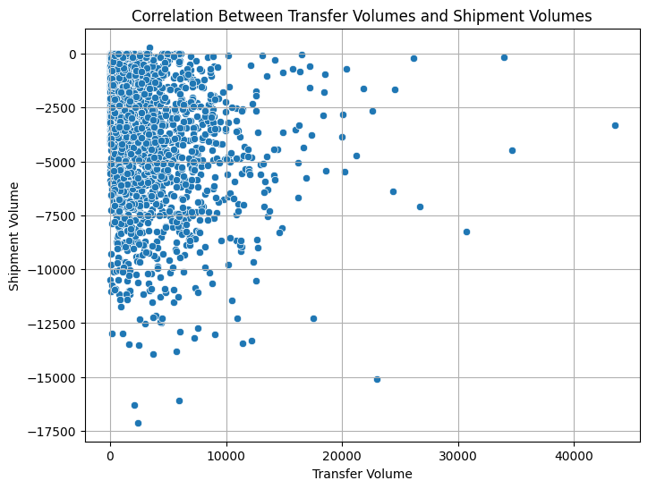
EDA – Trend of Location Transfers
The majority of transfer activity occurs in the first quarter of the year (January to March), with a significant drop during the middle months and a slight rise in November and December.
The scatter plot shows no strong correlation between transfer volumes and shipment volumes, with data points scattered widely and no clear pattern.
This suggests that intercompany transfers are not directly driving shipment volumes, indicating potential inefficiencies or misalignments in inventory management strategies.

Slide 71
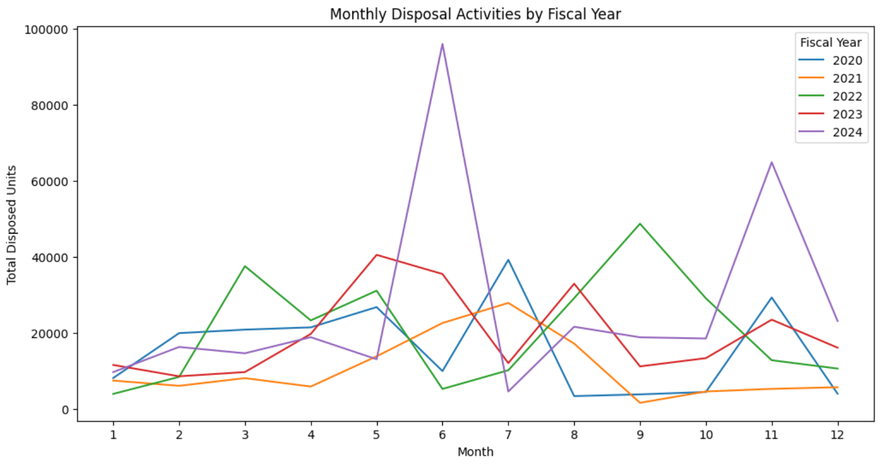
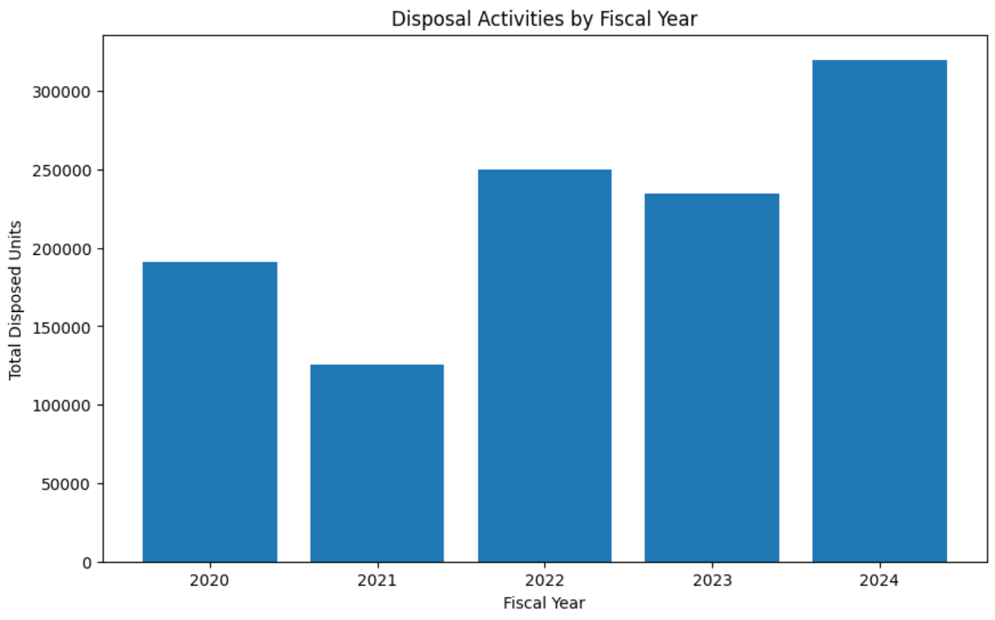
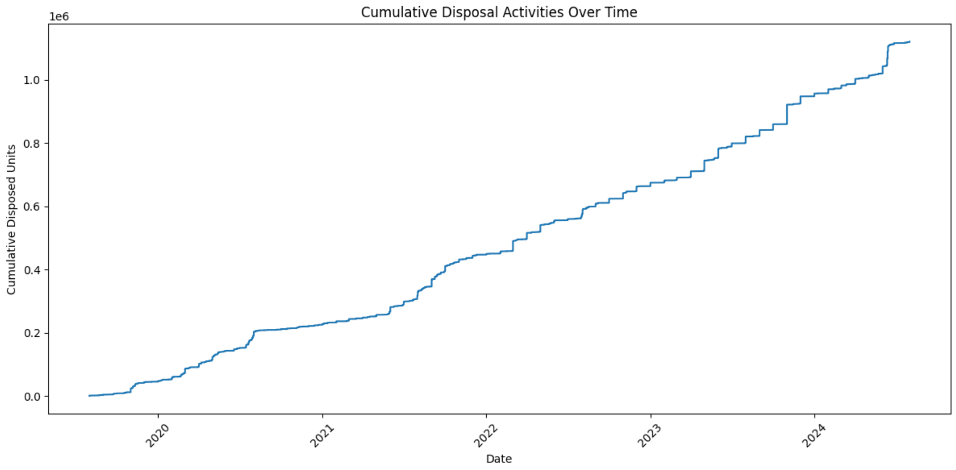
EDA – Trend of Disposal Activities

Slide 72
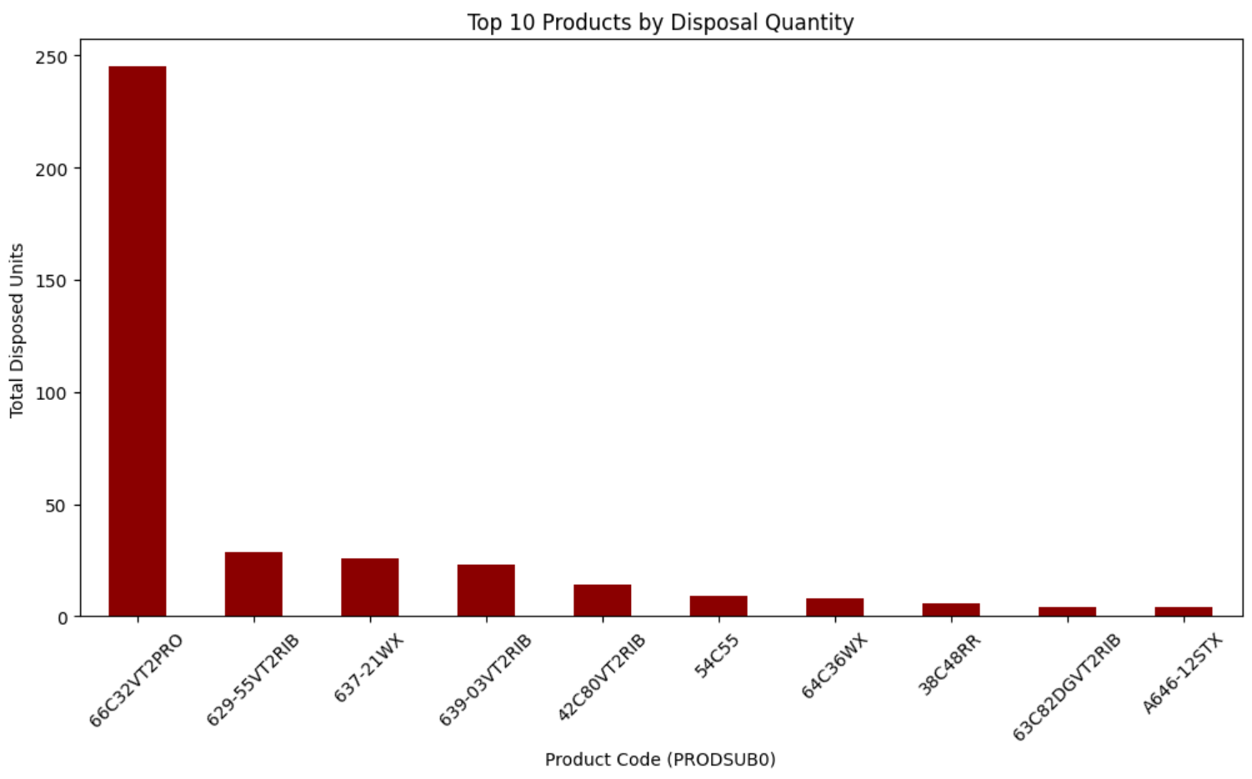
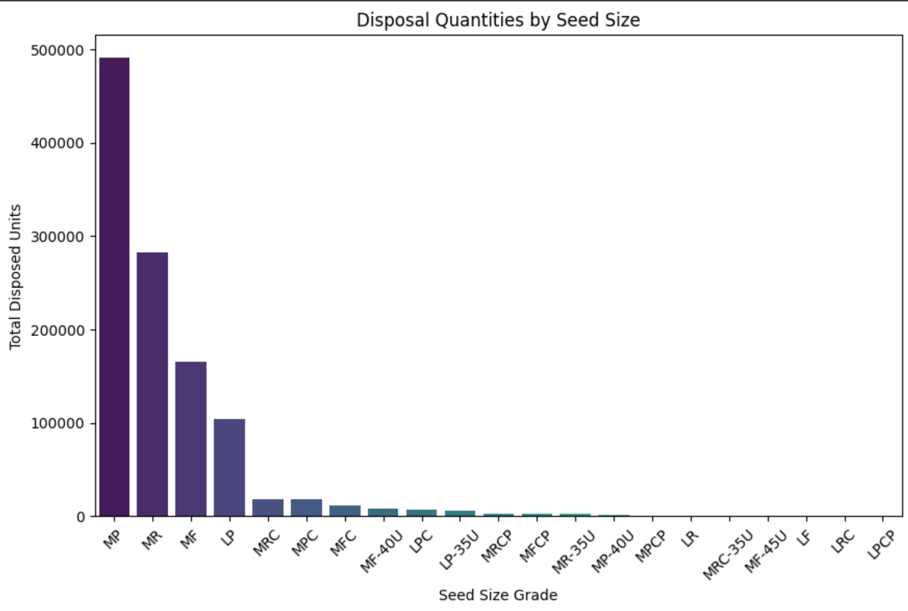
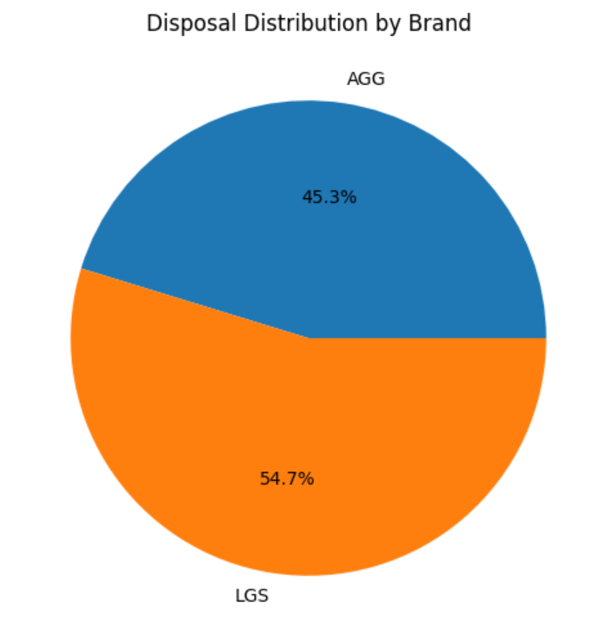
EDA – Trend of Disposal Activities

Slide 73
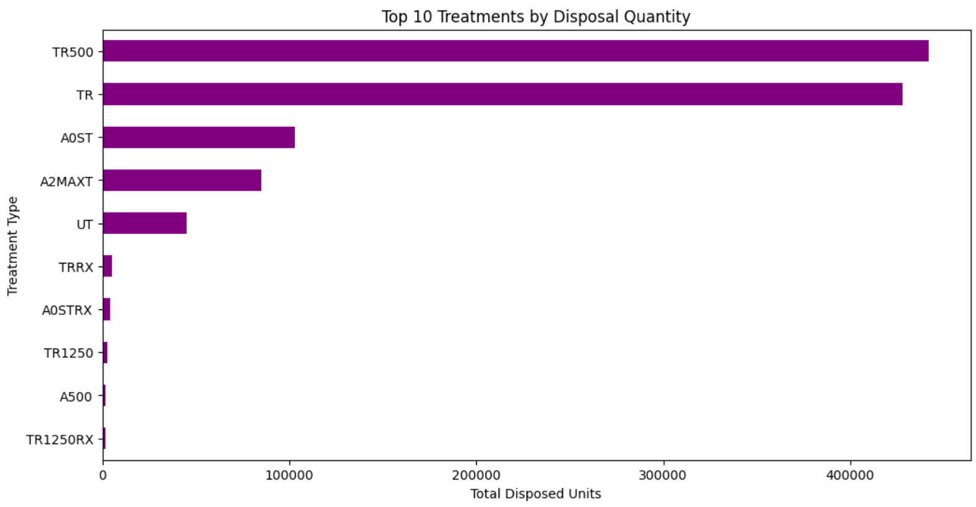
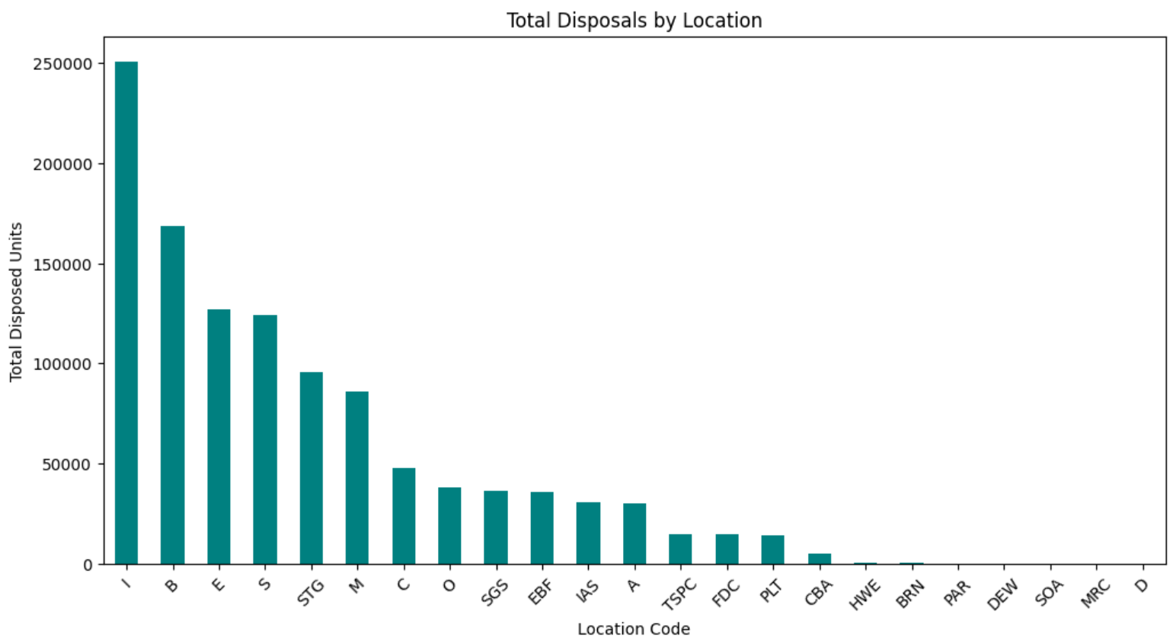
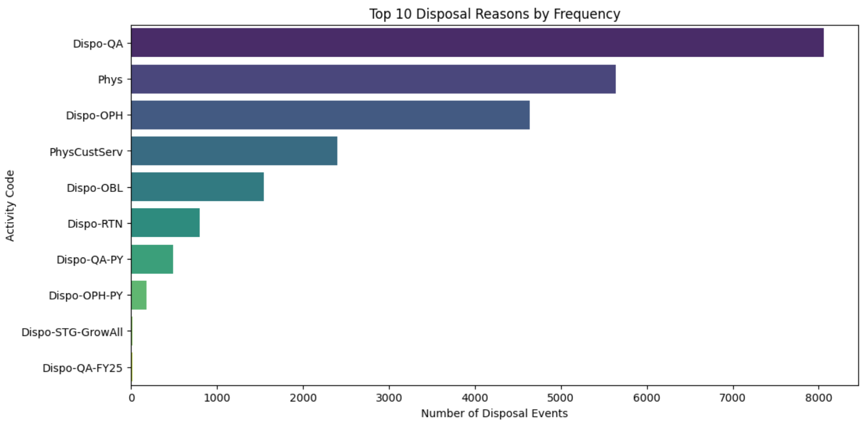
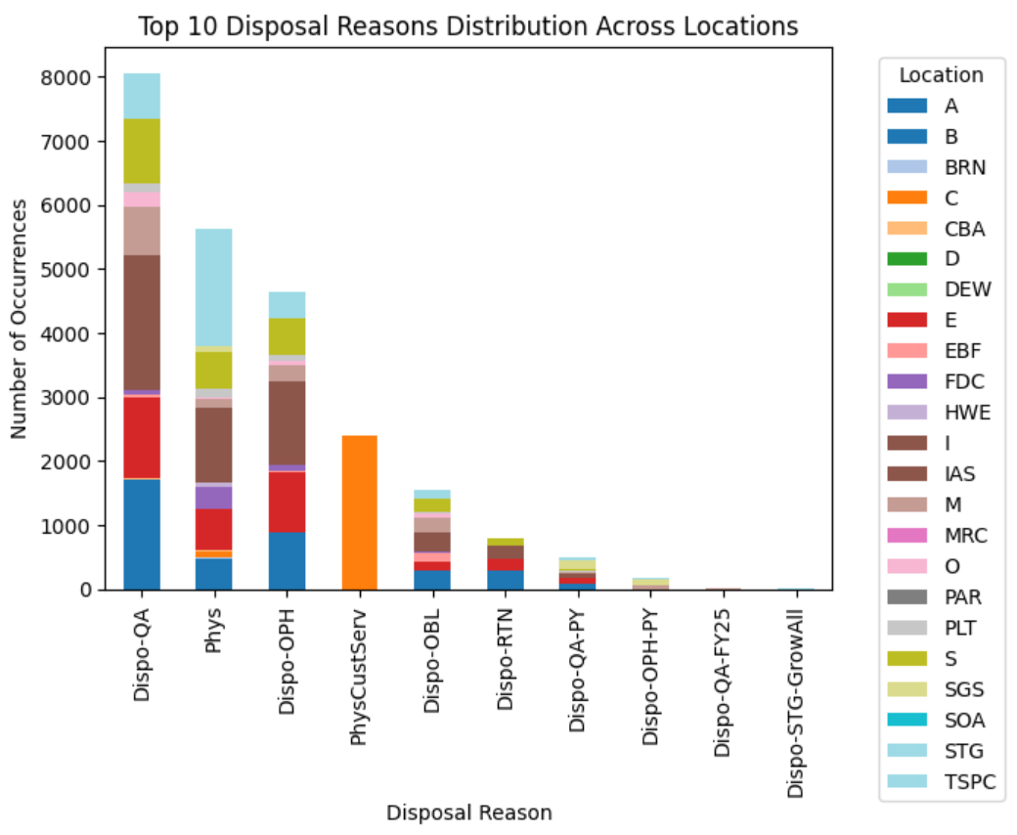
EDA – Trend of Disposal Activities

Slide 74
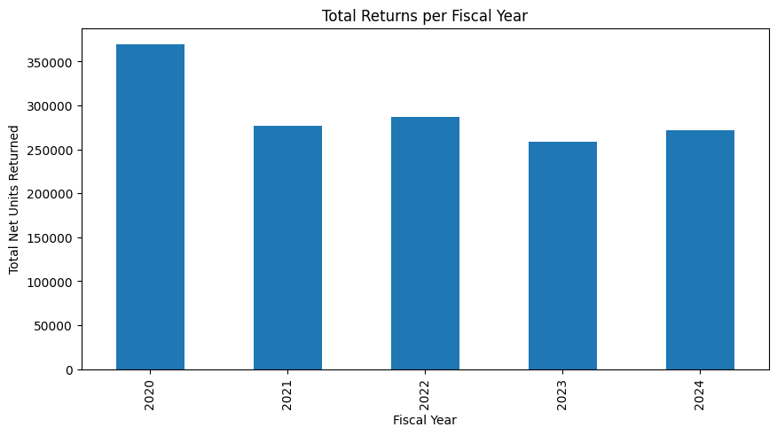
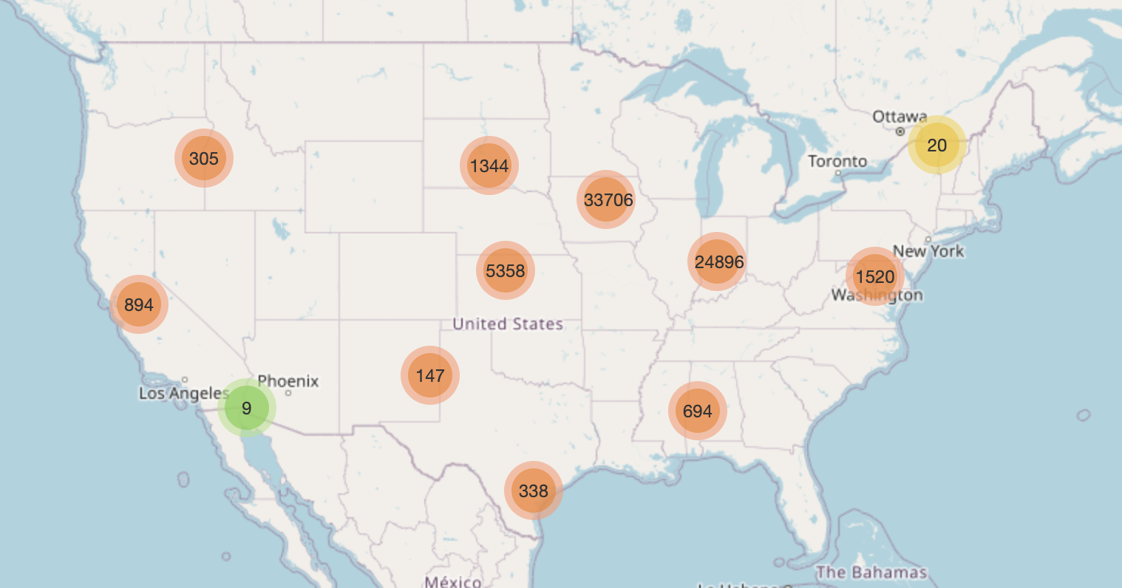
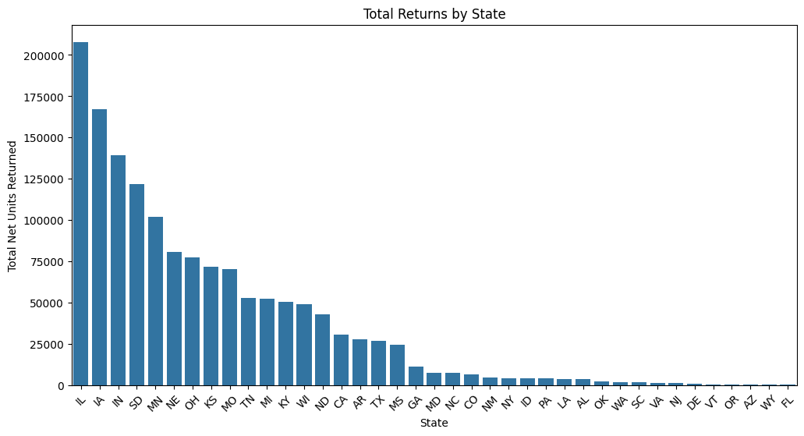
EDA – Trend of Return Activities
Map Visualization of Return Locations
The visualization shows return locations across the United States, with clusters indicating higher return volumes. Larger clusters in regions such as the Midwest and East Coast suggest concentrated return activities.
While returns have fluctuated, they remain consistently high, suggesting an ongoing trend of product returns over the years.
Few states account for the majority of returns. This insight can be valuable for logistics optimization and targeted strategies to reduce return rates in high-volume states.

Slide 75
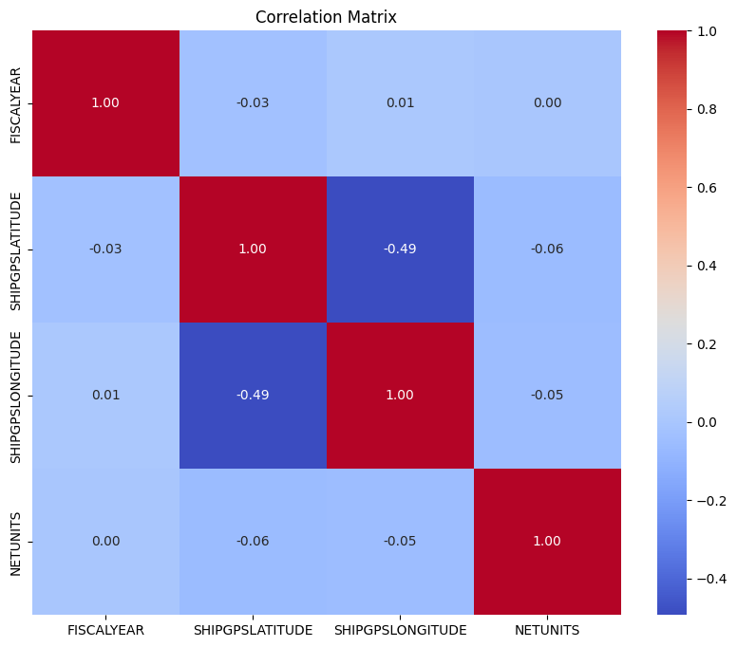
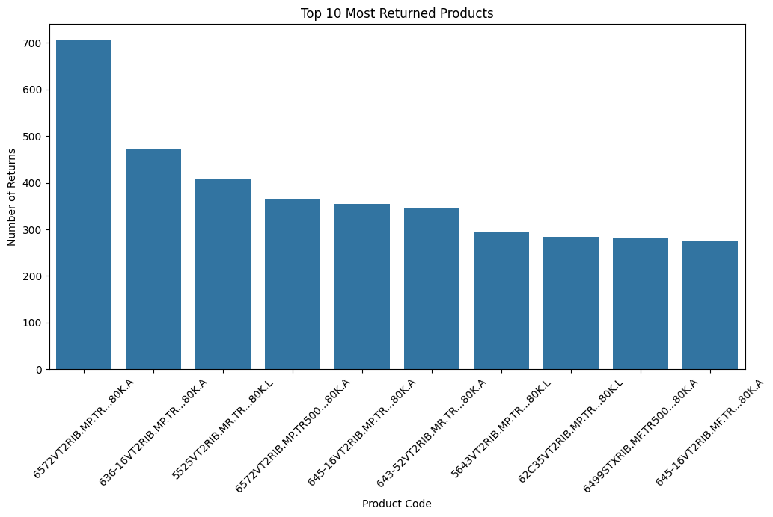
EDA – Trend of Return Activities
• Correlation Matrix: The weak correlations suggest that returns are not strongly influenced by location or fiscal year, indicating that returns might be driven by other factors like product defects or customer behavior.
• The top returned products suggests potential issues with specific product lines, such as quality concerns, packaging defects, or customer dissatisfaction.

Slide 76
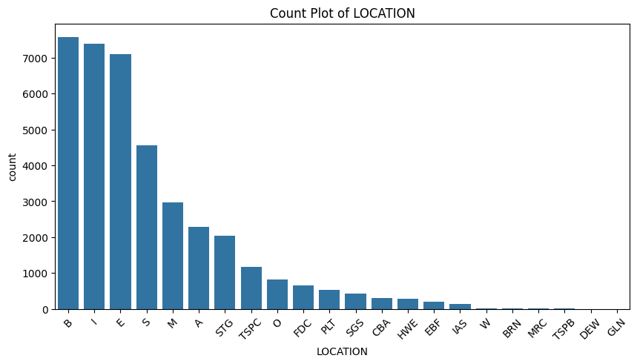
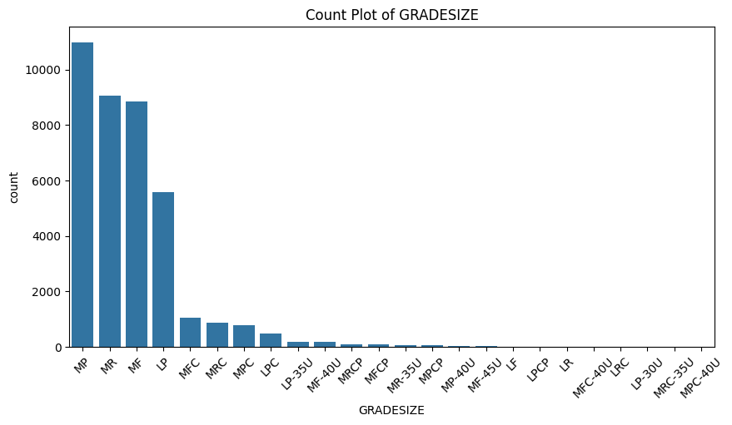


EDA – Beginning Inventory

Slide 77



EDA – Bagging Activities

Slide 78
Tracking additional data required
S. No | Data Required | Reason for Requirement
1 | Orders Data
2 | Shipment Fulfillment Data
3 | Truck Utilization
4 | …

Slide 79
Beginning Inventory - Questions
What is the significance of 31st July as 'Activity date'?
If the date in the table is 31st July, does it mean that is the end of that fiscal year?
In the product code, what does the code mean? (80K.L , 80K.A , 80K.W , 40K.L , 40K.A )
What is package type = 'SS'?

Slide 80
Bagging Activities - Questions
What is BCB, SS, and . in PACKAGETYPE?
What is BagOther and BagWntr in ACTIVITY CODE?
<1% of net units in bagging activities is negative, is that a concern?

Slide 81
Disposal Activities - Questions
Some values in the disposal activities were

Slide 82
Shipment - Questions
The following are possible concerns that we noticed in the data:
There is a location C in the shipment table that does not have a corresponding entry in location table, this location had only returns from 2020-2022, some sales in 2023 and returns again in 2024
There are 60 FY-Location combinations in the Shipment table where the Location in Shipment does not have a corresponding location in the Location Transfers table
<1% of net units in the shipment table contain positive values

Slide 83
Returns - Questions
Are orders returned to the same warehouse from where they were shipped ?
In case it can be returned to the other warehouse then what does the location field mean
Why do we have a mix of negative and positive values in the net unit field
How can we map returns to orders and shipment
Is there a scope of partial returns, if yes, how do we identify them

Slide 84
Location Transfers - Questions
What does it mean when the to and from locations are the same?
Why do we have a mix of negative and positive values in the net unit field?
What does the SS category mean in PACKAGETYPE columns?
What does the last part in PRODUCTCODE mean i.e., 40K.L, 80K.A etc.?

Slide 85
Story –
Executive Summary
Business Problem and Analytics Framing.
Problem Statement 1 – Excessive Shipments
Problem Statement deep dive
Funnel Slide
Talk about dashboard
Problem Statement 2 – Delivery Network Optimization
Problem Statement deep dive
Deliverables and improvements proposed
Problem Statement 3 – Intercompany Transfers

Slide 86

Methodological Workflow

Slide 87



Analysis walkthrough (Definition & Assumption)
Location Transfers
Production WH to Distribution WH
(July to Dec)
Distribution WH to Distribution WH
(Jan to June)
Stock Shortfall Ratio = Ratio of Transfers with respect to base inventory
Stock shortfall ratio is either constant or follows a trend (if no intervention) over years
For FY 2025, We can assume Base Inventory = Forecasted Demand * 1.35, where 0.35 is additional planning by AgReliant for uncertainty
Shortfall Ratio has been capped at 90th Percentile to avoid unrealistic estimation of safety units
Peak Sale Season
(63% Shipments)
(Feb to April)

Slide 88
Impact Generation/Key Takeaways from Analysis
Increased Risk of Customer Attrition
Critical Focus on Medium and Large Orders
Opportunity for Streamlined Fulfillment and Customer Experience
To what extent do excess shipments contribute to customer churn?
Churn/Retention Impact
Comparing each fiscal year to the previous one, we see average excess shipments increased from 1.02 in 2021 to 1.96 in 2024.
Over the same period, the retention rate dropped from 99.23% to 85.49%, indicating a corresponding rise in churn.
Business Benefit
This strong correlation implies that higher excess shipments may significantly drive churn.
Reducing excess shipments helps stabilize retention, preserving revenue and customer loyalty.
What strategies can effectively consolidate shipments for larger orders?
Consolidation Strategy Impact
Large Orders: From 2020 to 2024, average excess shipments rose from 4.49 to 6.19—a significant increase indicating frequent partial or multiple shipments.
Medium Orders: Over the same period, average excess shipments climbed from 1.33 to 2.24, reflecting a noticeable jump that can still heavily impact costs and customer satisfaction.
Small Orders: Although the average excess shipments for small orders rose from 0.22 to 0.60, it remains relatively low compared to medium and large orders, suggesting that large-scale consolidation efforts should prioritize the latter two categories first.
Business Benefit
By optimizing fulfillment (e.g., consolidating stock, refining demand forecasts) for medium and large orders, you can address the most substantial drivers of excess shipments.
Fewer split shipments lead to lower shipping costs, improved operational efficiency, and a better customer experience, especially for high-volume orders that can quickly escalate shipping expenses and frustration if poorly managed.
While small orders show a smaller jump in excess shipments, targeted tweaks—like scheduled batching or minimum order thresholds—can still enhance overall efficiency without detracting from the primary focus on medium and large orders.

Slide 90
Agenda

Slide 91
Thank You
Conclusion, call to action or contact information.

Slide 92
Live Demo of Deliverables
We will now walk the team through the deliverables generated for this project

Slide 93



Impact Generation/Key Takeaways from Analysis
Marketing Goals In 2024, appox 60% of shipments were highly/completely dependent on Intercompany transfers for order fulfilment
Revenue Out of Intercompany transfers done to Location S, 70% were done during peak sales season highlighting a bigger problem of Late / ad hoc Transfers. Similarly, 87% were done for Location E during Peak Sales Seasons.
Engagement Insights Intercompany transfers has been a major driver of logistic costs at warehouse S in FY 24

Slide 94
We identified a total of 6 business problems, 3 of which we plan to address within this project
These problems are within project scope
Delivery Inefficiency: Excess Shipments - Frequent, fragmented shipments increase costs and disrupt customer operations.
Intercompany Transfers - Excessive transfers between company locations result in logistical inefficiencies and increased lead times.
Warehouse Mapping to Customer - Inefficient mapping of warehouses to customers leads to delays and higher transportation costs.
Overlap of Supply Planning Cycle with Sale Seasons - Misaligned supply planning with peak sales seasons causes stockouts or overstocking.
Reliance on Contractors for Seed Production - Overdependence on contractors introduces variability in quality and supply timelines.
Falling Customer Retention - Declining customer loyalty due to perceived inefficiencies and dissatisfaction with delivery and service.

